Slide 2
African American Infant Mortality with Disparity Ratio compared to Whites United States

Slide 3
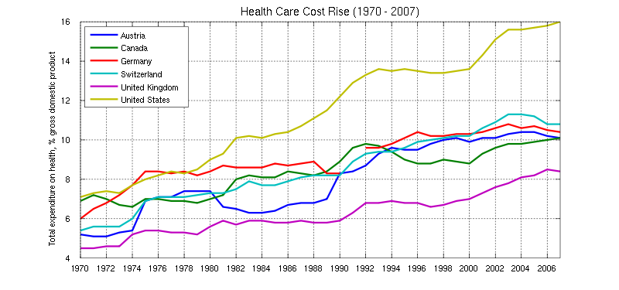
Current U.S. expenditure for healthcare is $8,666/person.

Slide 4
Excess Death Rate
Tool to quantify the greater infant mortality burden in a state relative to the rest of the country
  IMR in Region V State minus the IMR for all other Regions
  Ohio IMR (7.72) – IMR in all other Regions (6.49) = 1.23 excess deaths per 1,000 live births
  Since Ohio has ~150,000 births per year, that translates to 150*1.23 = ~185 excess infant deaths per year
HRSA
Notes:
So I kind of mentioned the concept earlier but I want to take the time to describe it in detail since most of the upcoming slides are going to present excess death rates
(Read from slide)
Since Ohio has ~150,000 births per year, that translates to 150*1.23=~185 excess infant deaths per year that wouldn’t occur if Ohio births had the same risk of dying as the rest of the country outside of Region V
This is a powerful number that many of you can calculate in serving as an advocacy and awareness tool in your state
In the Region overall, there are about 500 excess deaths annually or 1,500 over 3 years

Slide 5
Racial/Ethnic Components of
Excess Deaths*
* Compared to All Other Regions
HRSA
Notes:
So this slide shows overall excess infant deaths compared to the rest of the country
Negative numbers indicate lower infant mortality in a state relative to the rest of the country
So we see here that there is excess in all but MN and WI like we saw in an earlier slide
There are contributions shown in teal that reflect differences in racial/ethnic composition (i.e. higher % of Black births), which just reflects the disparity that is present nationwide – OH, MI, IL all have higher percentages of Black births
The purple areas reflect contributions due to having a higher Black IMR than the rest of the country and you can see there are contributions really in every state except MN
So both the teal and purple reflect disparities and higher Black infant mortality rates
The orange reflects contributions from higher White infant mortality rates and that is really again present in only OH, MI, IN
Because these states have higher proportions of White births (~70% or more compared to 50% in rest of country), a larger proportion of their greater overall IMRs are due to the higher White infant mortality rates
Just important to remember that disparities play a key role in the excess of every state but there are also higher white rates that need to be addressed too, particularly in IN, OH, MI
You can see actual fractions or percentages of your state’s excess (if there is an excess) in the handouts
So this really shows the need to focus on disparities, higher black rates, and higher white rates so let’s take a look at the Black-White gap in Region V and the rest of the country

Slide 6
Black Infant Mortality, 2007-09
* U.S.-born mothers
HRSA
Notes:
So if we select only U.S. born mothers for MN, Black IMR is now higher (not statistically significant due to smaller numbers)

Slide 7
Low Birth Weight Births–Less than 2,500 grams
 | Socioeconomic Tertile¹ | % Low Birth Weight
Cuyahoga County (2007-2011) | Lower SES | 13.7
 | Middle SES | 9.5
 | Higher SES | 7.6
Franklin County (2007-2011) | Lower SES | 12.0
 | Middle SES | 8.8
 | Higher SES | 7.1
Hamilton County (2007-2011) | Lower SES | 12.0
 | Middle SES | 9.5
 | Higher SES | 8.0
Ohio (2007-2011) |  | 8.6
United States (2007-2010) |  | 8.2
1- Socioeconomic status was defined by median household income and attainment of a bachelor degree by individuals 25 years of age or greater
Sources: Socioeconomic status calculated from American Community Survey 5 year estimates (2007-2011)
Ohio Risk Factor Data from Ohio Department of Health Vital Statistics Birth Files (2007-2011)
United States Estimates from National Vital Statistics System Birth Data (2007-2010)

Slide 8
Preterm Births–Less than 37 weeks gestation
 | Socioeconomic Tertile¹ | % Preterm
Cuyahoga County (2007-2011) | Lower SES | 17.9
 | Middle SES | 13.1
 | Higher SES | 10.9
Franklin County (2007-2011) | Lower SES | 15.9
 | Middle SES | 12.7
 | Higher SES | 10.8
Hamilton County (2007-2011) | Lower SES | 16.3
 | Middle SES | 13.0
 | Higher SES | 11.3
Ohio (2007-2011) |  | 17.9
United States (2007-2010) |  | 13.1
1- Socioeconomic status was defined by median household income and attainment of a bachelor degree by individuals 25 years of age or greater
Sources: Socioeconomic status calculated from American Community Survey 5 year estimates (2007-2011)
Ohio Risk Factor Data from Ohio Department of Health Vital Statistics Birth Files (2007-2011)
United States Estimates from National Vital Statistics System Birth Data (2007-2010)

Slide 9
Early Prenatal Care – First Trimester
 | Socioeconomic Tertile¹ | % with Early Prenatal Care
Cuyahoga County (2007-2011) | Lower SES | 57.5
 | Middle SES | 69.5
 | Higher SES | 78.3
Franklin County (2007-2011) | Lower SES | 54.8
 | Middle SES | 69.2
 | Higher SES | 80.4
Hamilton County (2007-2011) | Lower SES | 54.2
 | Middle SES | 71.3
 | Higher SES | 79.1
Ohio (2007-2011) |  | 54.8
United States (2007-2010) |  | 67.9
1- Socioeconomic status was defined by median household income and attainment of a bachelor degree by individuals 25 years of age or greater
Sources: Socioeconomic status calculated from American Community Survey 5 year estimates (2007-2011)
Ohio Risk Factor Data from Ohio Department of Health Vital Statistics Birth Files (2007-2011)
United States Estimates from National Vital Statistics System Birth Data (2007-2010)

Slide 10
Maternal Smoking During Pregnancy
 | Socioeconomic Tertile¹ | % Smoking
Cuyahoga County (2007-2011) | Lower SES | 15.5
 | Middle SES | 10.2
 | Higher SES | 4.7
Franklin County (2007-2011) | Lower SES | 22.0
 | Middle SES | 12.2
 | Higher SES | 4.7
Hamilton County (2007-2011) | Lower SES | 16.8
 | Middle SES | 12.3
 | Higher SES | 7.8
Ohio (2007-2011) |  | 18.5
United States (2007-2010) |  | 9.5
1- Socioeconomic status was defined by median household income and attainment of a bachelor degree by individuals 25 years of age or greater
Sources: Socioeconomic status calculated from American Community Survey 5 year estimates (2007-2011)
Ohio Risk Factor Data from Ohio Department of Health Vital Statistics Birth Files (2007-2011)
United States Estimates from National Vital Statistics System Birth Data (2007-2010)

Slide 11
Infant Mortality Rate – per 1,000 live births
 | Socioeconomic Tertile¹ | Infant Mortality Rate
Cuyahoga County (2007-2011) | Lower SES | 12.3
 | Middle SES | 8.6
 | Higher SES | 4.1
Franklin County (2007-2011) | Lower SES | 11.1
 | Middle SES | 6.2
 | Higher SES | 4.0
Hamilton County (2007-2011) | Lower SES | 11.4
 | Middle SES | 8.9
 | Higher SES | 7.0
Ohio (2007-2011) |  | 7.7
United States (2007-2010) |  | 6.6
1- Socioeconomic status was defined by median household income and attainment of a bachelor degree by individuals 25 years of age or greater
Sources: Socioeconomic status calculated from American Community Survey 5 year estimates (2007-2011)
Ohio Risk Factor Data from Ohio Department of Health Vital Statistics Birth Files (2007-2011)
United States Estimates from National Vital Statistics System Birth Data (2007-2010)

Slide 12
2011-2013 USA Infant Mortality Rates, by State and by Race, from Worse to Best:
 | Overall: |  |  | White: |  |  | Black: |  |  | Hispanic:
USA | 6.01 |  |  | 5.06 |  |  | 11.25 |  |  | 5.09
MS | 9.25 |  | WV | 6.99 |  | KS | 14.18 |  | RI | 7.22
AL | 8.57 |  | AL | 6.92 |  | ^WI | 14 |  | PN | 6.99
LA | 8.35 |  | ME | 6.77 |  | ^OH | 13.57 |  | OH | 6.92
DE | 7.64 |  | MS | 6.76 |  | ^MI | 13.13 |  | KS | 6.84
OH | 7.6 |  | AR | 6.7 |  | ^IL | 12.93 |  | KY | 6.75
AR | 7.41 |  | OK | 6.51 |  | AL | 12.9 |  | ID | 6.68
SC | 7.23 |  | IN | 6.46 |  | UT | 12.89 |  | OK | 6.54
NC | 7.2 |  | KY | 6.4 |  | ^IN | 12.87 |  | MS | 6.35
IN | 7.19 |  | OH | 6.31 |  | DE | 12.82 |  | AR | 6.15
OK | 7.17 |  | LA | 6.15 |  | PN | 12.66 |  | IN | 6.09
TN | 7.16 |  | TN | 6.09 |  | NC | 12.57 |  | MO | 6.08
*MA | 4.21 |  | *NJ | 3.20 |  | *MA | 6.90 |  | *IA | 2.65
Note that in each IMR group Ohio is the only State amongst the worst “10” in the USA for each group
^Also note 5 of the 6 States that make up Perinatal Region V are amongst the worst for black IMR
*Best Rates in Green
NCHS: 8/6/2015

Slide 13
Why should Ohio care?
The math has caught up to us:
  #7 for births/State per year, yet only State amongst worst for Overall, White, Black, and Hispanic IMR (August, 2015, NCHS, data from 2011-2013)
Even the people at the top are affected by disparities.
  “We all do better when we all do better!” Paul Wellstone
  Social justice.
    “The philosophy behind science is to discover truth. The philosophy behind medicine is to use that truth for the benefit of your patient. The philosophy behind public health is social justice.” Wm Foege
    Disparities are mostly the result of policy decisions that systematically disadvantage some populations over others, especially populations of color. (Dr. Ed Ehlinger, DOH MN, current ASTHO President)
    Healthy People 2010 recognized that communities, States, and national organizations will need to take a multi-disciplinary approach to achieving health equity – an approach that involves improving health, education, housing, labor, justice, transportation, agriculture, and the environment, as well as data collection itself. (HP 2010)
Notes:
(even asking the question raises the fact that we’ve ”normalized” higher rates of IM among blacks).
so that we have an opportunity to change what’s going on in other states

Slide 14

Disparities in Birth Outcomes are the tip of the health disparities iceberg
Disparities in Birth Outcomes
Heart disease
Cancer
Asthma
Unwanted pregnancies
Alcoholism
Diabetes
Hypertension
Stroke
Cirrhosis
Drug abuse
Homicide
Obesity
Nephritis
HIV
Dementia
STDs
Substance Use
Renal failure
COPD
Injuries
Influenza
Tuberculosis
Suicide
Depression
Malnutrition
Anxiety
Notes:
And for AA families who continue to experience all of the sequela that accompany marginalized citizenship, we will continue to experience substantial health care disparities.

Slide 15
Determinants of Health
Necessary conditions for health (WHO)
Peace
Shelter
Education
Food
Income
Stable eco-system
Sustainable resources
Health Care
Social justice and equity
World Health Organization. Ottawa charter for health promotion. International Conference on Health Promotion: The Move Towards a New Public Health, November 17-21, 1986 Ottawa, Ontario, Canada, 1986. Accessed July 12, 2002 at <http://www.who.int/hpr/archive/docs/ottawa.html>.

Slide 16
“…the opportunity to be healthy is not equally available everywhere or for everyone in the state.”
Our hope is that we can improve this circumstance by addressing both the clinical and non-clinical circumstances that influence our health.

Slide 17
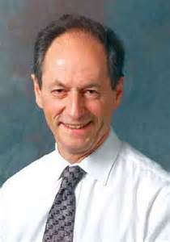
“…a moral obligation, a matter of social justice.”
“The medical profession (and Public Health) seeks not only to understand but also to improve things. (But) Many professionals feel queasy about the prospect of social action to improve health…because it smacks of “social engineering.”
Yet, a physician faced with a suffering patient has an obligation to make things better. If she sees 100 patients the obligation extends to all of them. And if a society is making people sick? We have a duty to do what we can to improve the public’s health and to reduce health inequalities in social groups where these are avoidable and hence inequitable or unfair. This duty is a moral obligation, a matter of social justice.”
Marmot, Health in an Unequal World

Slide 18




Many (most) of our Policy Prescriptions and Programmatic Interventions: try to help families “circumvent” obstacles…
Most of these
programs help
In some cases, they
make a huge difference
BUT…most programs represent
temporary solutions. Once
pregnancy ends, we return
families to the same
circumstances that required
help in the first place…and
the cycle repeats itself pregnancy
after pregnancy AND generation
after generation.
art james

Slide 19
YMP Component & BMA Element:
DEVELOP & IMPLEMENT STRATEGIES
Children’s Services in LA County Source: Margaret Dunkle, IEL
Education
Health & Food
Social Services
Child & Family
Services
Mental Health & Probation
Public Schools
ESEA, Title I
School Lunch & Breakfast
Head Start
IDEA
After-School Programs
Textbook Funding
Tests & Achievement
Teacher Issues
GED
Medi-Cal – EPSDT
Healthy Families Parent Expansion
Child Health & Disability Program
Expanded Access Primary Care
Trauma Case Funding
Co-payments for ER Services
Child Lead Poisoning Prevention Program
HIV/AIDS Prevention & Education
Breast Cancer Screening
Food Stamps
WIC
TANF
GAIN, CAL Learn, Cal WORKS, etc.
Child Care – CCDBG, SSBG, Cal WORKS Child Care, etc.
After-School Programs – 21st Century Learning Centers, etc.
Promoting Safe & Stable Families
Child Abuse & Neglect Programs
Foster Care – Transition, Independent Living, Housing, etc.
Adoption Assistance, Adoption Opportunities
School-Based MH Services for Medi-Cal Kids
Probation Officers in Schools
Cardenas-Schiff Legislation
Health Care Through Probation
Mental Health Evaluations
Juvenile Halls
Boyfriend in trouble
Mom
Dad
9 year old
5 year old
Baby 1 1/2
Mom’s sister

Slide 20
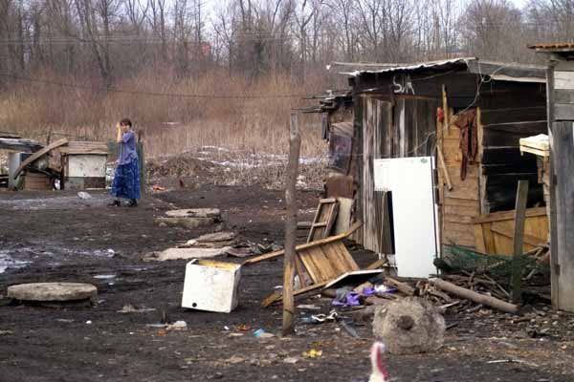
Why treat people’s illnesses without changing the conditions that made them sick?
(WHO Commission on Social Determinants of Health, 2008)

Slide 21
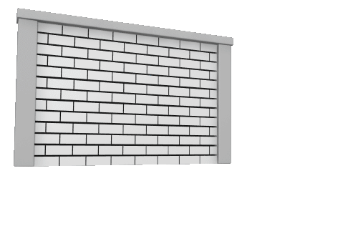
A Social Determinants approach: challenges us to “eliminate the obstacles”
Obstacles:
art james

Slide 22


We are often asked...which Social Determinants to improve?
Poverty
Education
Policy
RACISM
Community revitalization
Housing
Unemployment
Wealth Gap
Under resourced
community
Racism
Teen Pregnancy
Infant Mortality
Ethnic Minority
School dropout
Poverty
art james
Notes:
My dentist tells me “you only have to floss the teeth you want to keep”. Of course, his point is that they are all important, so you have to floss all of them. It is the same with the SDOH…while some have more influence on disparities than others…we have to address them all. This then requires achieving “collective impact”…to align our MCH efforts with similar efforts from the Dept of Education, the DOJ, Dept of Housing/HUD, etc. along with business, civil rights organizations…because HRSA is not equipped to handle all of this.

Slide 23
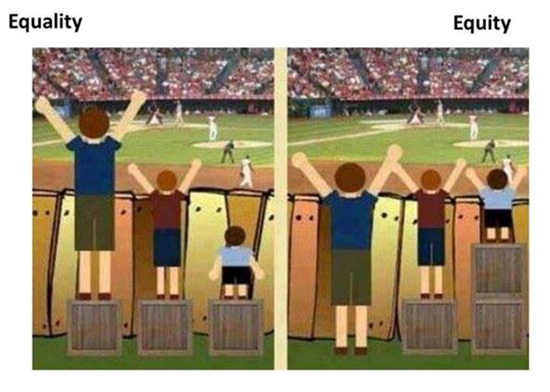
Advancing health equity is not about averages
It’s about creating opportunities to be healthy

Slide 25
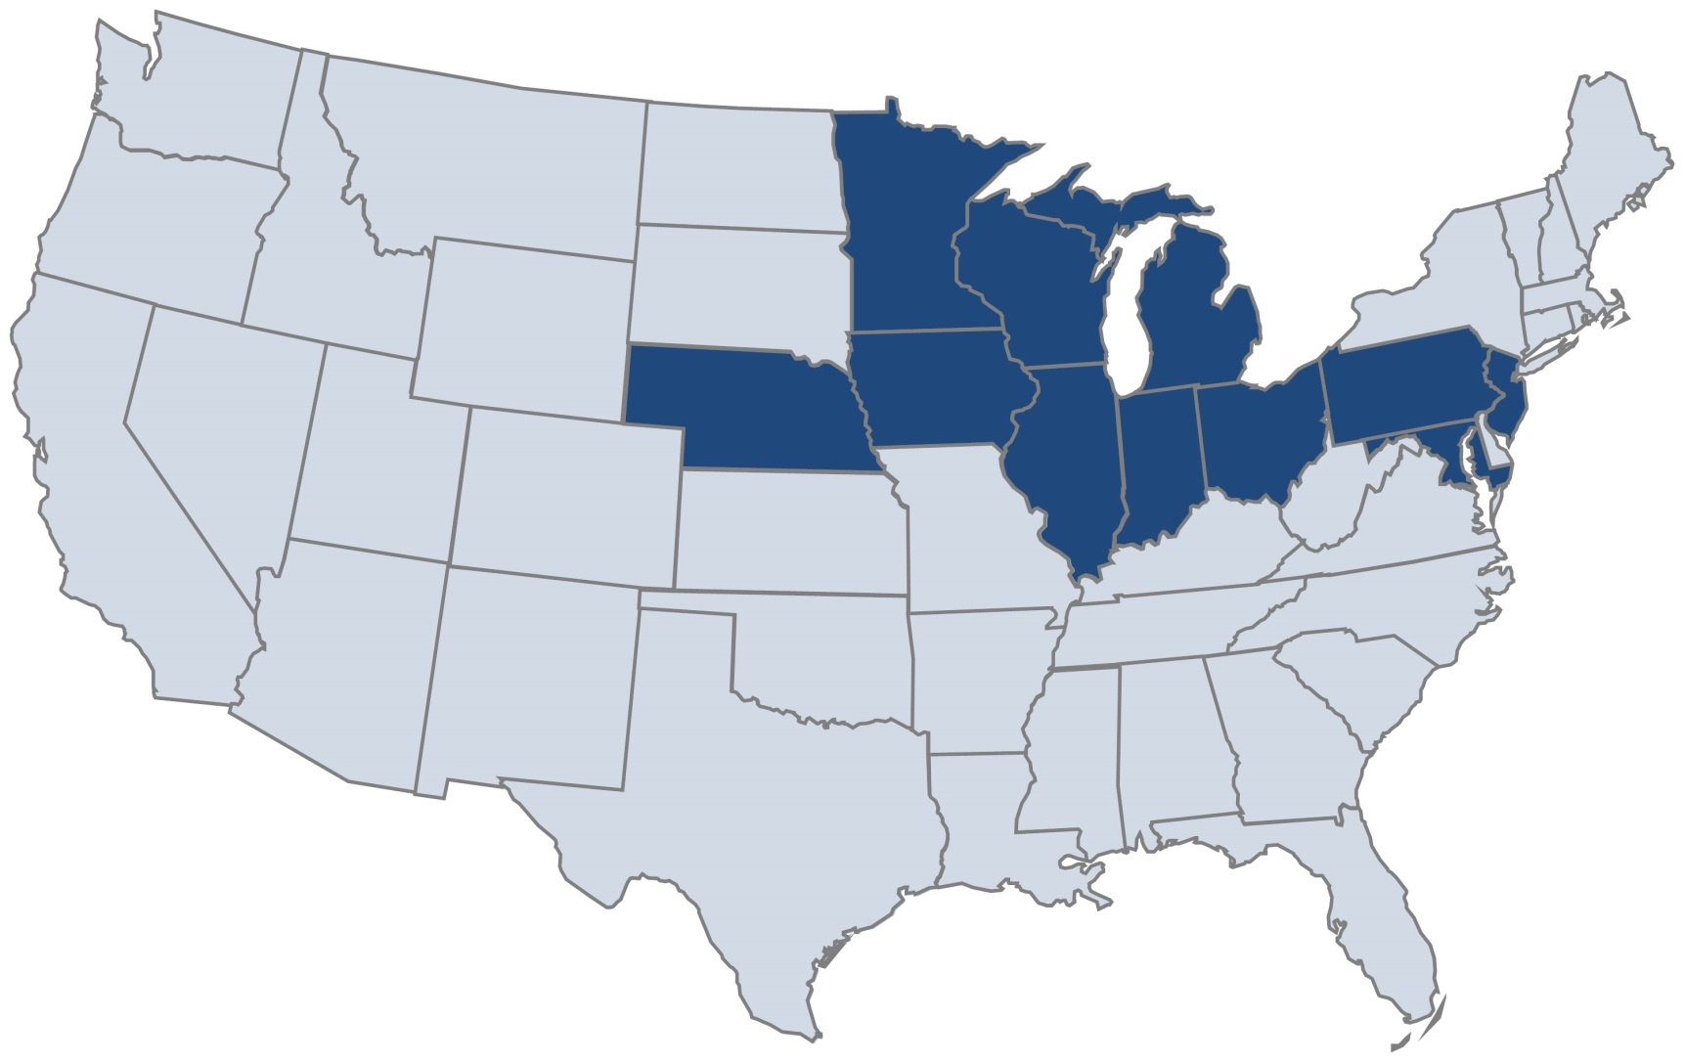
Social Determinants of Health – How’s OH doing?
Comparison of Big 10 (CIC) States

