Slide 1

FROM MICRO TO MACRO: ADDRESSING INFANT MORTALITY HOLISTICALLY
December 5, 2019
Ohio Commission on Infant Mortality

Slide 2

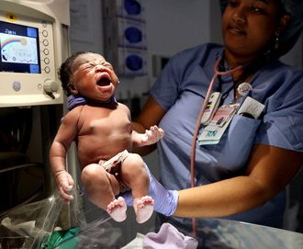
Mission
To address and improve the systemic and community structures that lead to poor birth outcomes through culture, education, advocacy, support and engagement
Notes:
We are a group of trained doulas.

Slide 3
Micro-Level
Direct Service
Culture
Empowerment

Slide 4
Macro-level
Systems Change
Equitable Allocations

Slide 5
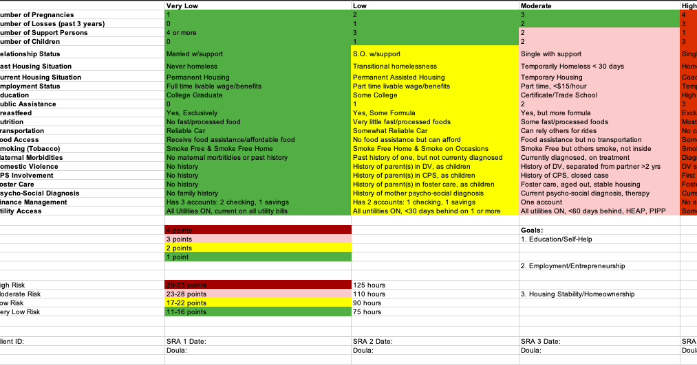
Social Risk Assessment

Slide 6
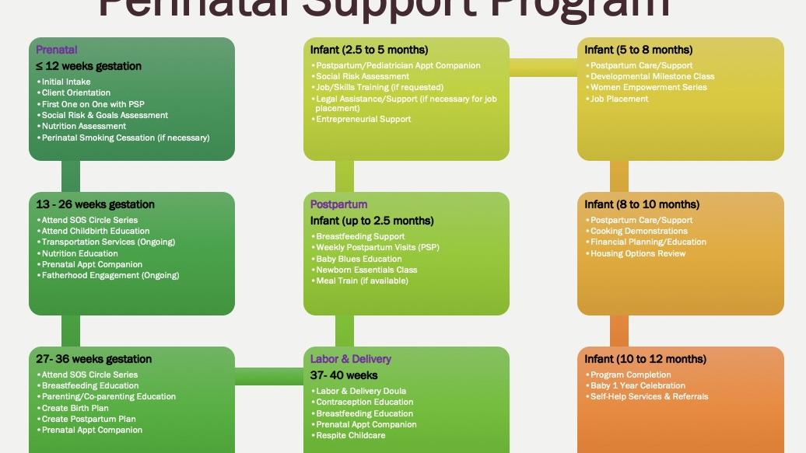

Slide 7
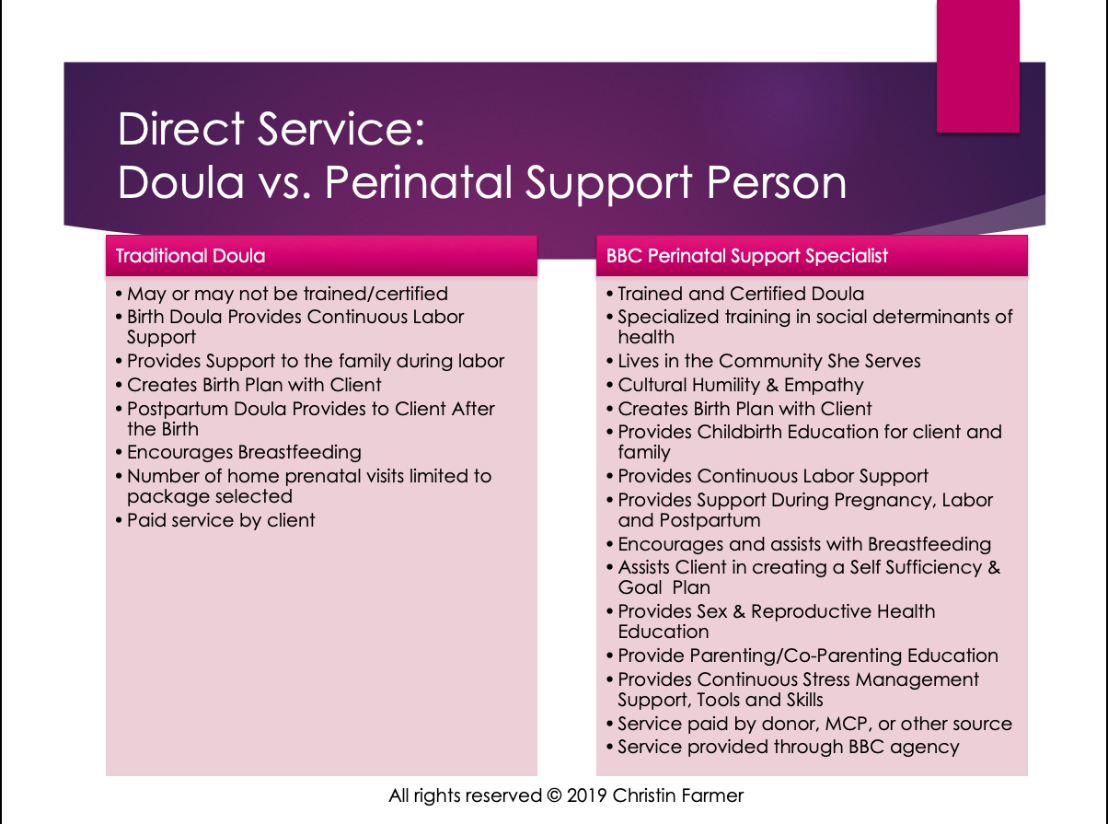

Slide 8
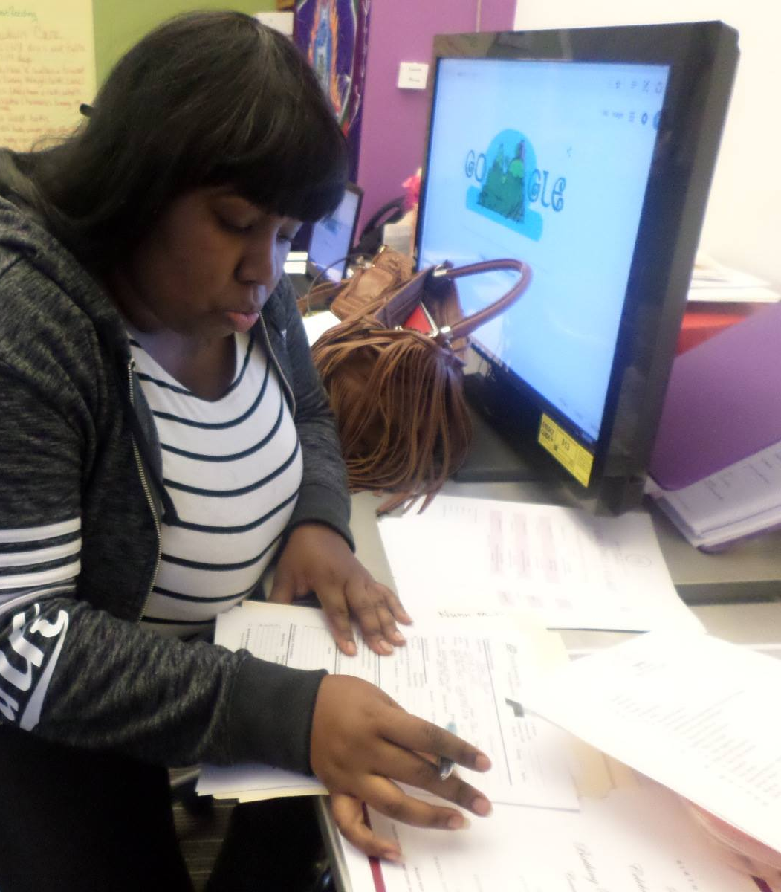
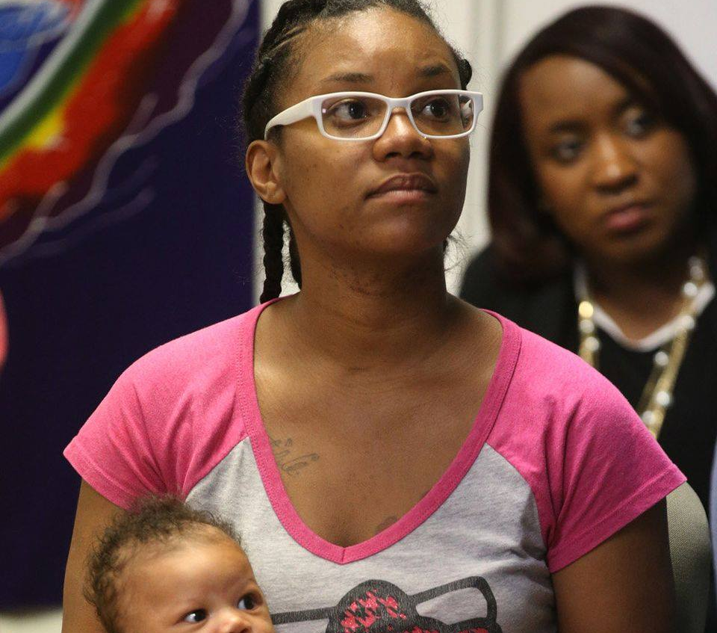
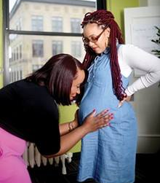
Cultural Intervention
Continuous System of Support
Knowledge of Self Through History
Representation & Empowerment
The African American Experience & Trauma
                Ancestral Trauma
                Vicarious Trauma
                Personal Trauma

Slide 9
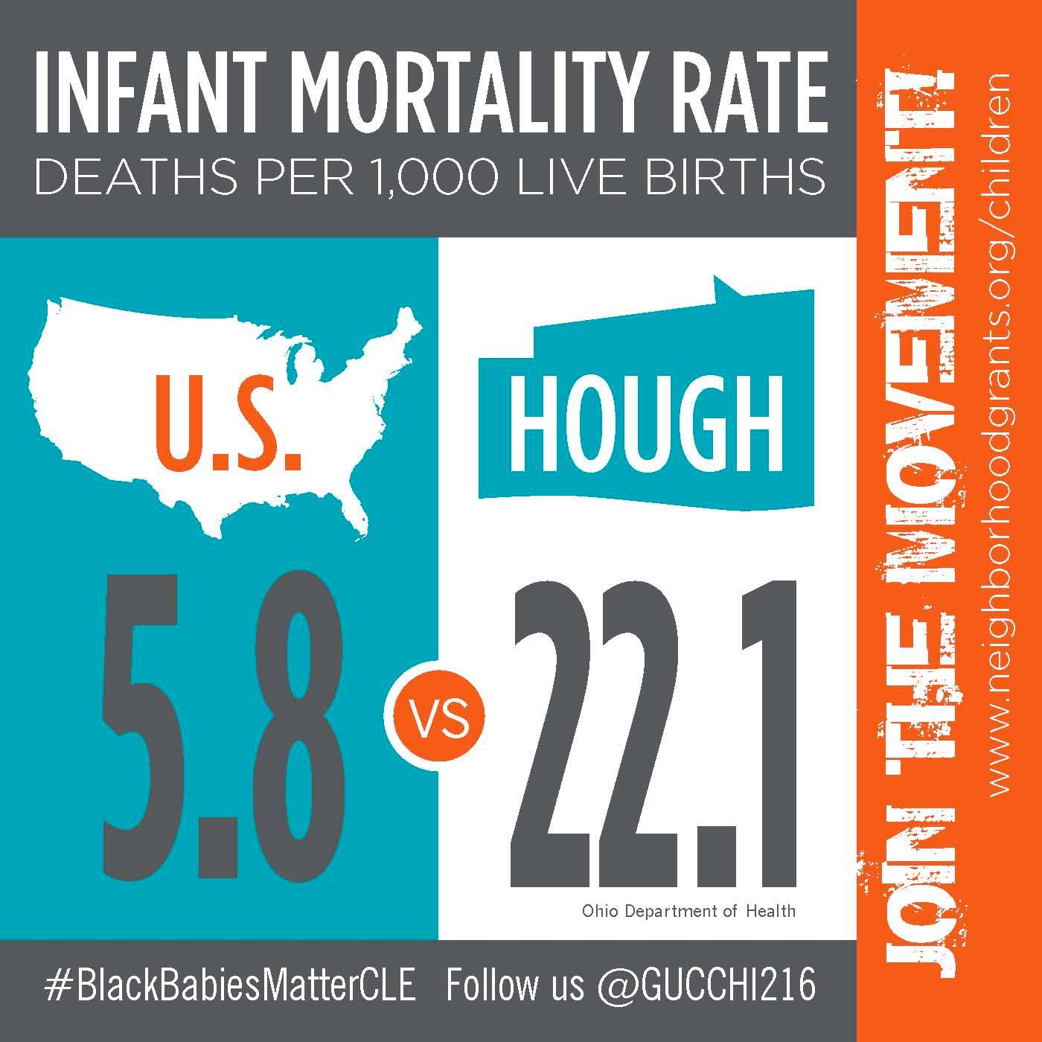
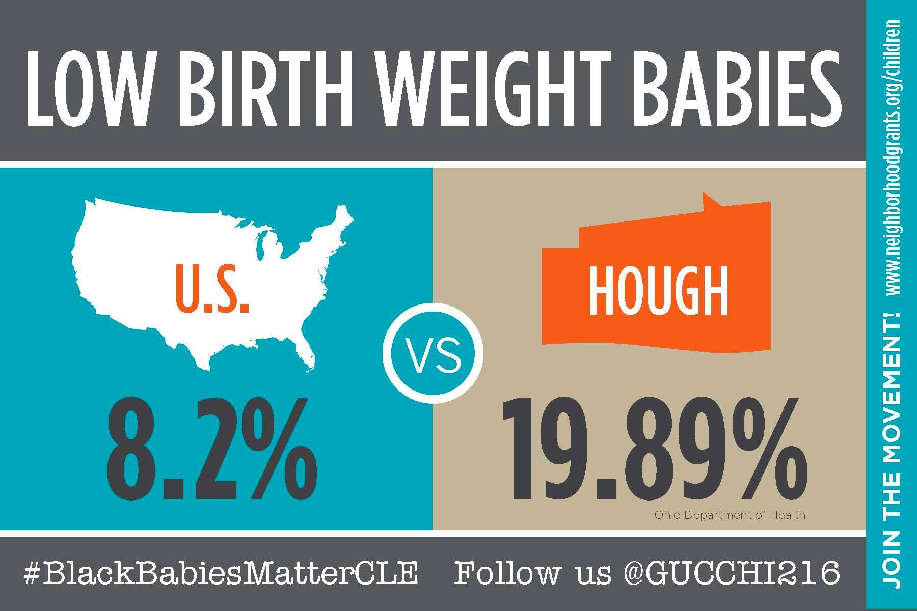
Infants in Hough
Infant Death
Low Birth Weight

Slide 10

Hough Demographics & Statistics
97 % African American
Median Household Income of $18,900
66% Income < $29,000
77% Female Head of Household
95% Functioning Illiteracy
24% Vacant Homes
18% Homeowners

Slide 11
Macro-level
Systems Change
Equitable Allocations

Slide 12
Black Infant Mortality is just a symptom of a much larger problem

Slide 13
BBC’s Vision
Holistic Birth Equity
Preconception
Pregnancy
Postpartum
Housing
Workforce
Maternal Mental Health
Education
Business
Justice/Legal
Sister Support
Nutrition
Childbirth Education
Sister Support
Support Group
Newborn Education
Laws & Advocacy
Environmental Assessment
Maternal-Child Care
Health Care
SOS Circle
Nutrition
Nutrition
Home Ownership
Post Secondary/Trade
Finances/Investments
Entrepreneurship
MBE/WBE
Representation
Legal Advice
Perinatal Smoking Cessation
2B Nurtured
PAIL
Wealth Collective
Parenting/Co-parenting
Next Step
Comprehension Sex Education
Institution Awareness

Slide 14
Outcomes
African American Birth Outcomes
 | BBC (N=119) | USA | Ohio (2017) | Cuyahoga (2016) | Cuyahoga (2017) | Cleveland
Low birthweight | 11.8 | 13.89 | 11.1 | 12.3 | 12.0 | 13.7
Very low birthweight | 0.0 | 2.95 | 3.1 | 3.5 | 4.2
Prematurity | 8.5 | 13.93 | 14.4 | 16.0 | 16.5 | 14.5
Extreme Prematurity | 0.0 | 3 |  |  | 4.5
Cesarean | 21.8 | 36 | 31.7 | 32.1 | 31.4
Infant Death | 0.08 | 11.4 | 15.6 |  | 16.27 | 12.3
Breastfeeding | 81.4 | 64.3 | 64.3 | 63.4 | 67.6

Slide 15
Cost of Care
 | Kangaroo Care (125 Hours) | Cub Care (110 Hours) | Fawn Care (90 Hours) | Kitten Care (75 Hours)
Pregnancy | $1000 (50) | $800 (40) | $600 (30) | $400 (25)
Birth | $500 | $500 | $500 | $500
Postpartum | $1500 (75) | $1400 (70) | $1200 (60) | $1100 (50)
Maximum Costs | $3,000 | $2700 | $2300 | $2000

Slide 16
Return on Investment
$5,560 per participant, per year in BBC programming
We save, lives

Slide 17
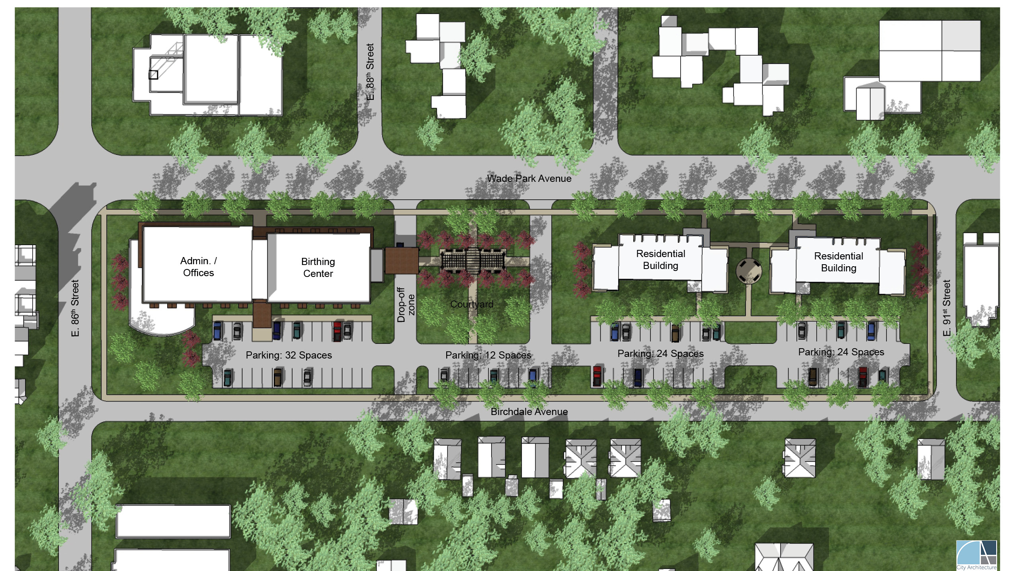

Slide 18
Birthing Beautiful Campus
Admin Office
Birthing Center
Short Term Housing
Day to Day BBC Functioning
Onsite Childcare Center
Mental Health Wing – Stress and Trauma
Education & Training
Four to Five Birthing Rooms
Free standing BC within 130 miles
20 units
3-4 DV/Emergency units
Not gender specific
Programming
Wrap Around Services

Slide 19
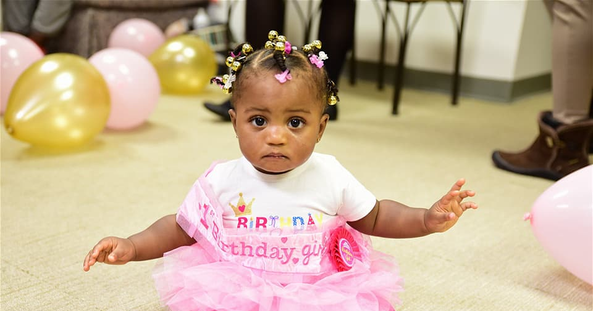
We must be the change in which we seek

