Slide 1
A Call to Action for Ohio to SAVE ALL Ohio Mothers and Babies:
Presentation to Ohio Commission on Infant Mortality
November 10, 2020
Lisa Amlung Holloway Arthur R. James MD, FACOG
Director of Maternal and Infant Health Initiatives Consultant, First Year Cleveland
March of Dimes, Ohio Member, Ohio Commission on Infant Mortality

Slide 2
3
Notes:
Goodbye Debbie

Slide 3
OUR GOALS
  END PREVENTABLE
  Maternal Health
  Risks and
  Death
  END PREVENTABLE
  Preterm Birth
  and Infant
  Death
End the Health Equity Gap
FOR HEALTHY MOMS. STRONG BABIES.
Notes:
We have two clear goals – End preventable maternal risks and deaths and End preventable preterm birth and infant death. To achieve these goals, we know we have to end the health equity gap - to realize our vision of a world where every mom and baby is healthy regardless of wealth, race of geography.
We fight for Health Moms, Strong Babies.

Slide 4

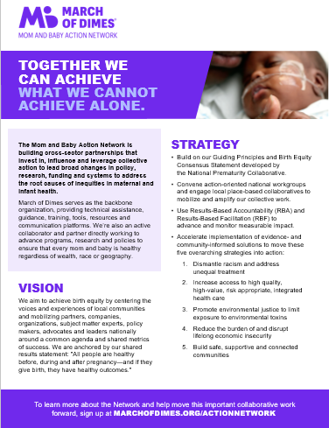
Transforming from the National Prematurity Collaborative, which was launched by March of Dimes in 2016.
Engaging cross-sector partners to invest in, influence, and leverage collective action to address the root causes of inequities in maternal and infant health.
Addressing complex, systemic and multi-layered issues with solutions that are carefully orchestrated to ensure high alignment.
Leading broad measurable changes in policy, research, funding and systems. Together we can achieve what we cannot achieve alone.
To Join the Mom and Baby Action Network
https://www.marchofdimes.org/ActionNetwork
Notes:
Builds on the achievements and thought leadership of the National Prematurity Collaborative, which was launched by March of Dimes in 2016 with CDC support.
The Mom and Baby Action Network (M-BAN) engages cross-sector partners to invest in, influence, and leverage collective action to address the root causes of inequities in maternal and infant health.
The issues are complex, systemic and multi-layered. As such, they require complex solutions carefully orchestrated to ensure high alignment. The moment to move from data to action is now.
Through M-BAN, March of Dimes leads broad measurable changes in policy, research, funding and systems. Together we can achieve what we cannot achieve alone.
The Mom and Baby Action Network is one of our key vehicles for implementation, mobilization, and thought leadership.

Slide 5
NATIONAL Equity FRAMEWORK = COMMON AGENDA
All people are healthy before during and after pregnancy and if they give birth, they have healthy outcomes.
R
% of live births born preterm (before 37 weeks)
Preterm birth disparity ratio for United States
Maternal mortality rate
Severe maternal morbidity
Chronic hypertension in women aged 15-44
Chronic diabetes in women aged 15-44
I
S
Dismantle racism and address unequal treatment
Increase access to high quality, healthcare
Promote environmental justice
Disrupt lifelong economic insecurity
Build safe & connected communities
A
B
C
D
E
To Join the Mom and Baby Action Network
https://www.marchofdimes.org/ActionNetwork
Notes:
This is a graphic depiction of how the active engagement work with over 550 partners and subject matter experts over the last year shook up to become the National Equity Framework.
We have a Shared Results Statement, a list of population level indicators we want to move, and five overarching strategies. Underneath these strategies we then have over 190 different solutions that partneWe create value for our stakeholders and partners through facilitating connections to:
Experts and Technical Assistance
Trainings, Resources, and Tools
Volunteers, Advocates, and Staff
Data and Evaluation
Innovations and Best Practices
Local and National Visibility
rs will be able to prioritize and help implement where and when appropriate, across the nation, to help advance our common agenda.

Slide 6
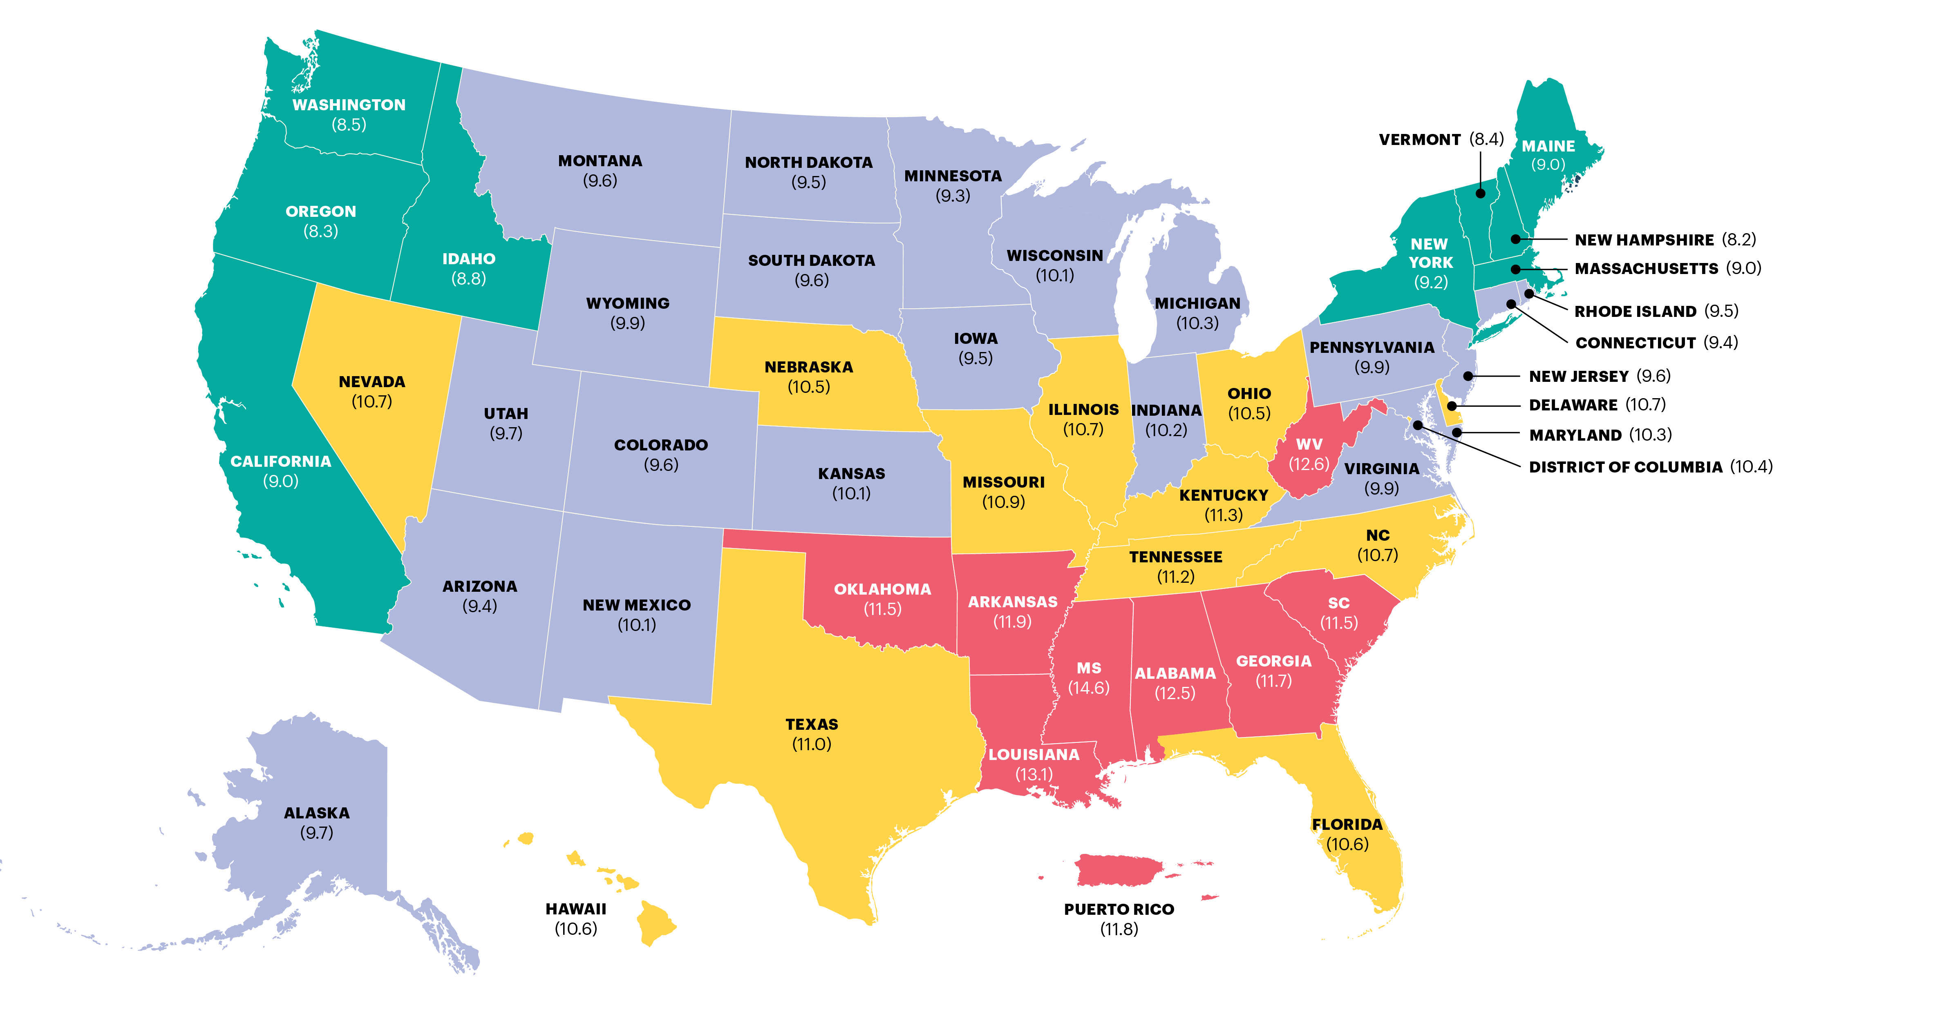
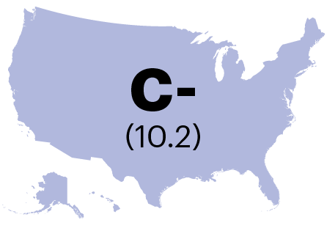
2020 MARCH OF DIMES REPORT CARD
PRETERM BIRTH RATES AND GRADES BY STATE
Grade for national preterm birth rate
Hispanic
GRADE | PRETERM BIRTH RATE RANGE SCORING CRITERIA
A | Less than or equal to 7.7%.
A- | Preterm birth rate of 7.8 to 8.1%.
B+ | Preterm birth rate of 8.2 to 8.5%.
B | Preterm birth rate of 8.6 to 8.9%.
B- | Preterm birth rate of 9.0 to 9.2%.
C+ | Preterm birth rate of 9.3 to 9.6%
C | Preterm birth rate of 9.7 to 10.0%
C- | Preterm birth rate of 10.1 to 10.3%
D+ | Preterm birth rate of 10.4 to 10.7%.
D | Preterm birth rate of 10.8 to 11.1%.
D- | Preterm birth rate of 11.2 to 11.4%.
F | Preterm birth rate greater than or equal to 11.5%.
Preterm is less than 37 weeks gestation based on obstetric estimate.
Source: National Center for Health Statistics, 2019 final natality data.
MARCHOFDIMES.ORG/REPORTCARD

Slide 7
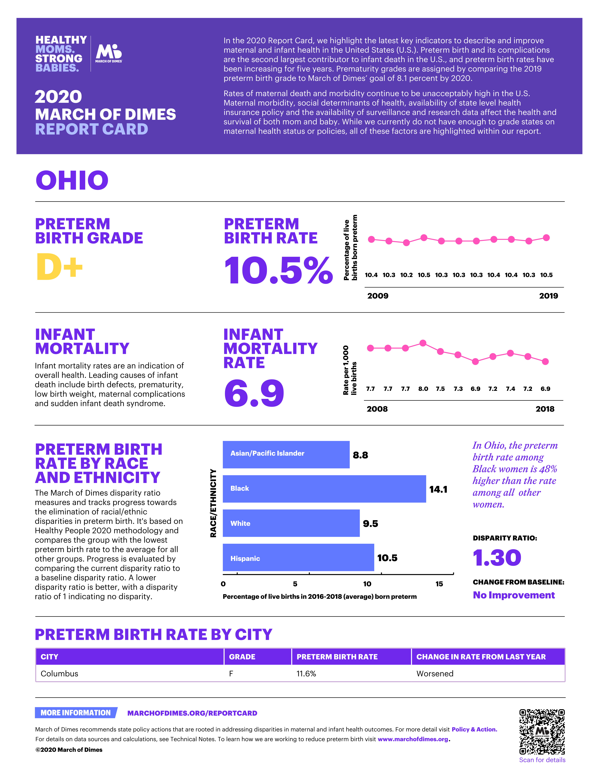
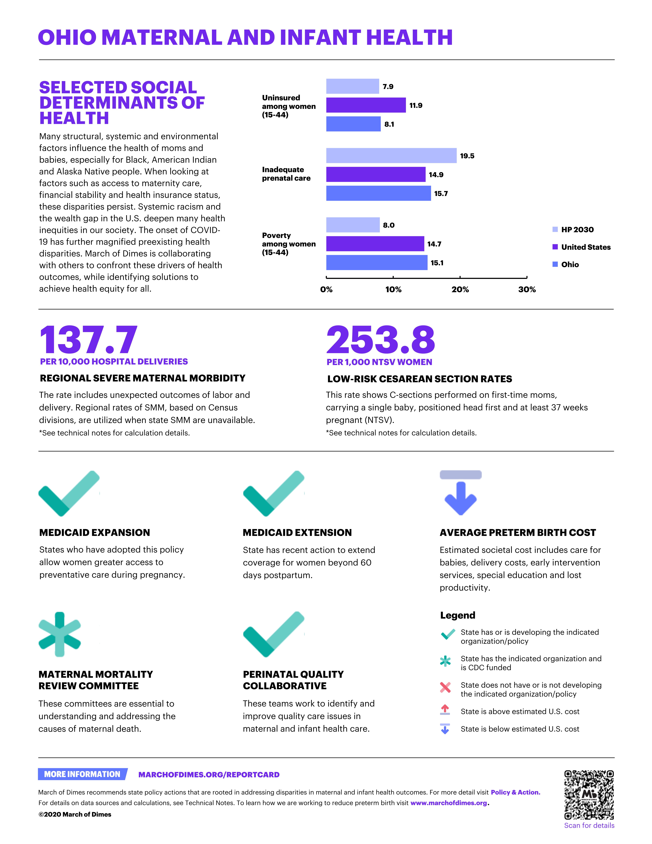
2020 MARCH OF DIMES REPORT CARD

Slide 8
2020 MARCH OF DIMES REPORT CARD
In the 2020 Report Card we highlight the latest key indicators to describe and improve maternal and infant health in the United States (U.S.). Preterm birth and its complications are the second largest contributor to infant death in the U.S., and preterm birth rates have been increasing for five years. Prematurity grades are assigned by comparing the 2019 preterm birth grade to March of Dimes’ goal of 8.1 percent by 2020.
Rates of maternal death and morbidity continue to be unacceptably high in the U.S. Maternal morbidity, social determinants of health, availability
of state level health insurance policy and the availability of surveillance and research data affect the health and survival of both mom and baby.
While we currently do not have enough to grade states on maternal health status or policies, all of these factors are highlighted within our report.
OHIO
PRETERM BIRTH GRADE
PRETERM
BIRTH RATE
D+
Percentage of live births that are preterm
10.5%
2009
2019
Grade and Range
A
B+
B
B-
C+
C
C-
D+
D
D-
F
7.8 – 8.1
8.2 - 8.5
8.6 – 8.9
9.0 – 9.2
9.3 – 9.6
9.7 – 10.0
10.1 – 10.3
10.4 – 10.7
10.8 – 11.1
11.2 – 11.4
11.5 or greater
Preterm is based on less than 37 weeks gestation based on obstetric estimate.
Source: National Center for Health Statistics: final natality data 2009-2019
MARCHOFDIMES.ORG/REPORTCARD

Slide 9
2020 MARCH OF DIMES REPORT CARD
PRETERM BIRTH RATE BY RACE AND ETHNICITY
Asian/Pacific Islander
Black
White
Hispanic
In Ohio, the preterm birth rate among Black women is 48% higher than the rate among all other women.
Preterm is less than 37 weeks gestation based on obstetric estimate.
Race categories include only women of non-Hispanic ethnicity.
Source: National Center for Health Statistics, final natality data 2016-2018
MARCHOFDIMES.ORG/REPORTCARD

Slide 10
2020 MARCH OF DIMES REPORT CARD
PRETERM BIRTH RATE BY RACE AND ETHNICITY
The March of Dimes disparity ratio measures and tracks progress towards the elimination of racial/ethnic disparities in preterm birth. It’s based on Healthy People 2020 methodology and compares the group with the lowest preterm birth rate to the average for all other groups. Progress is evaluated by comparing the current disparity ratio to a baseline disparity ratio. A lower disparity ratio is better, with a disparity ratio of 1 indicating no disparity.
Hispanic
DISPARITY RATIO
CHANGE FROM BASELINE
1.30
Average of everyone else
11.4
No Improvement
Preterm is less than 37 weeks gestation based on obstetric estimate.
Race categories include only women of non-Hispanic ethnicity.
Source: National Center for Health Statistics, final natality data 2016-2018
MARCHOFDIMES.ORG/REPORTCARD

Slide 11
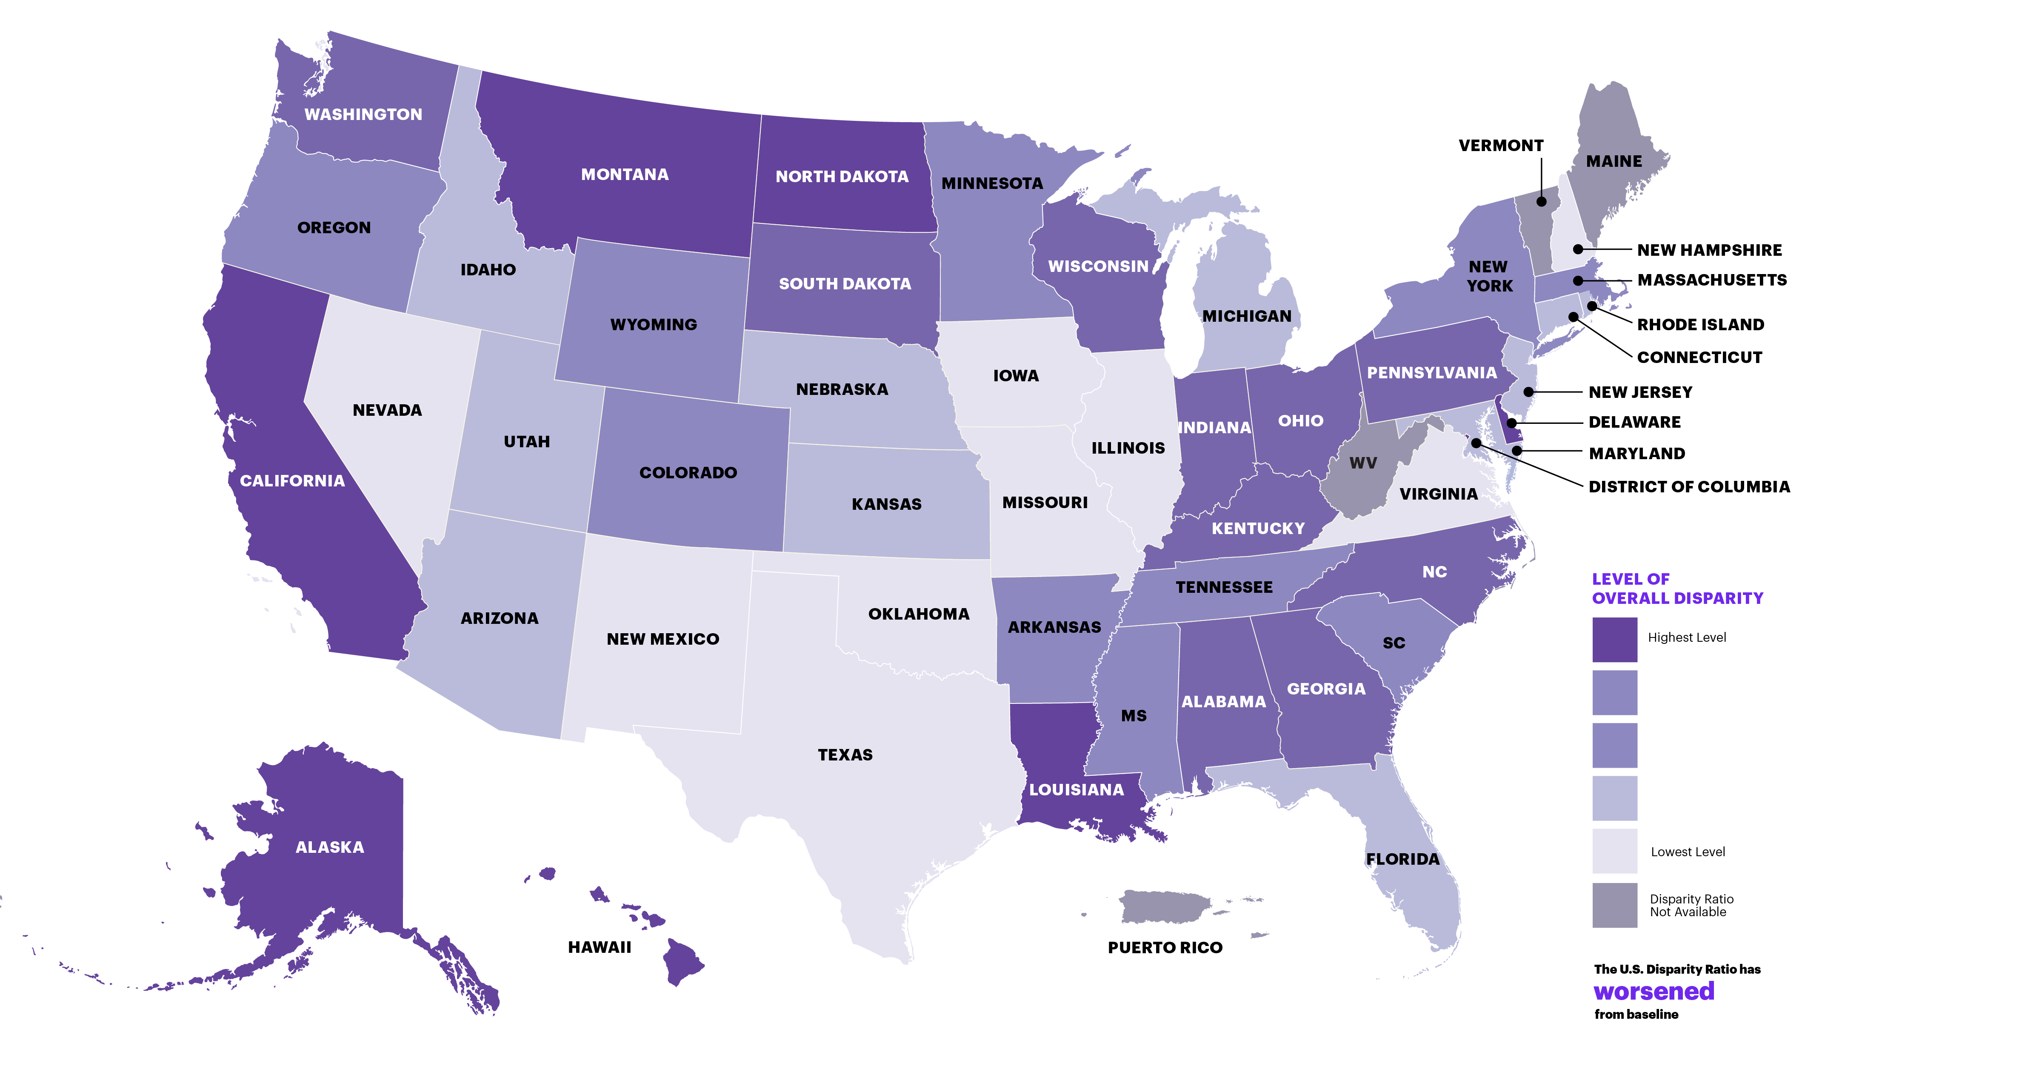
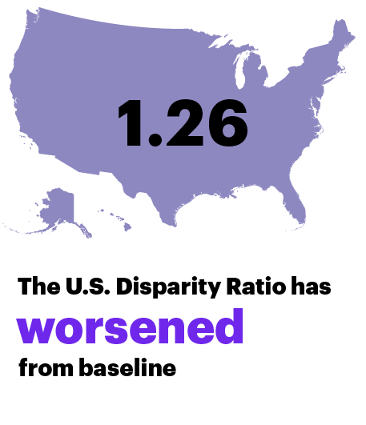
2020 MARCH OF DIMES REPORT CARD
RACE & ETHNICITY DISPARITY BY STATE
The March of Dimes disparity ratio measures and tracks progress towards the elimination of racial/ethnic disparities in preterm birth. It's based on Healthy People 2020 methodology and compares the group with the lowest preterm birth rate to the average for all other groups. Progress is evaluated by comparing the current disparity ratio to a baseline disparity ratio. A lower disparity ratio is better, with a disparity ratio of 1 indicating no disparity.
U.S. disparity ratio
Hispanic
Gestational age is based on obstetric estimate.
Race categories include only women of non-Hispanic ethnicity.
Source: National Center for Health Statistics, 2016-2018 natality data.
MARCHOFDIMES.ORG/REPORTCARD

Slide 12
2020 MARCH OF DIMES REPORT CARD
SELECTED SOCIAL DETERMINANTS OF HEALTH
Many structural, systemic, and environmental factors influence the health of mothers and babies, especially for Black, American Indian and Alaska Native people. When looking at factors such as access to maternity care, financial stability, and health insurance status, these disparities persist. Systemic racism and the wealth gap in the U.S. deepen many health inequities in our society. The onset of Covid-19 has further magnified preexisting health disparities. March of Dimes is collaborating with others to confront these drivers of health outcomes, while identifying solutions to achieve health equity for all.
Uninsured
among women
(15-44)
Hispanic
HP 2030
Inadequate
prenatal care
United States
Ohio
Poverty
among women
(15-44)
Source: IPUMS-USA, University of Minnesota, ipums.org. 2018 American Community Survey. US Census Bureau; IPUMS-CPS, University of Minnesota, ipums.org. 2019 Current Population Survey. US Census Bureau; National Center for Health Statistics, 2018 final natality data.
MARCHOFDIMES.ORG/REPORTCARD

Slide 13
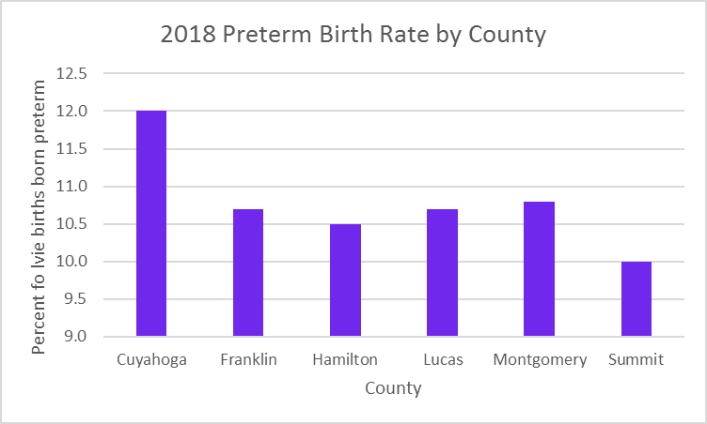
Grade and Range
A
B+
B
B-
C+
C
C-
D+
D
D-
F
7.8 – 8.1
8.2 - 8.5
8.6 – 8.9
9.0 – 9.2
9.3 – 9.6
9.7 – 10.0
10.1 – 10.3
10.4 – 10.7
10.8 – 11.1
11.2 – 11.4
11.5 or greater

Slide 14
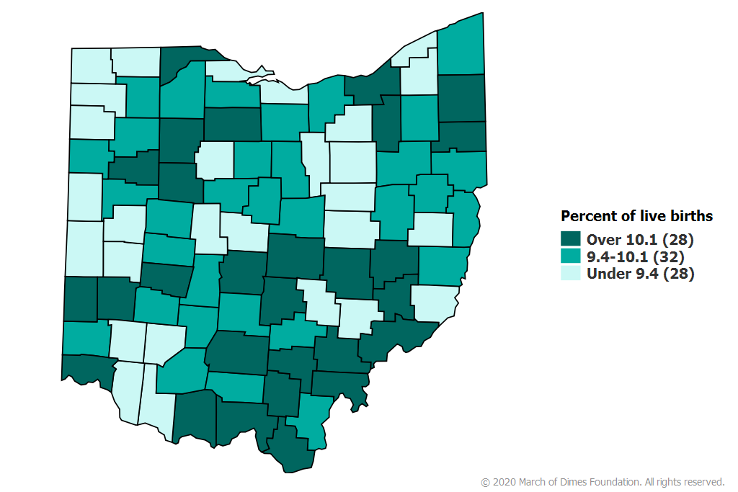
PRETERM BIRTH
OHIO, 2015-2018 AVERAGE
Preterm is less than 37 weeks of pregnancy.
Source: National Center for Health Statistics, final natality data. Retrieved October 29, 2020, from www.marchofdimes.org/peristats.
MARCHOFDIMES.ORG/REPORTCARD

Slide 15








2020 MARCH OF DIMES REPORT CARD
MEDICAID EXPANSION
MEDICAID EXTENSION
AVERAGE PRETERM BIRTH COST
States who have adopted this policy allow women greater access to preventative care during pregnancy.
State has recent action to extend coverage for women beyond 60 days postpartum.
Estimated societal cost includes care for babies, delivery costs, early intervention services, special education and lost productivity.
Legend
State has or is developing the indicated organization/policy
State has the indicated organization and is CDC funded
State does not have or is not developing the indicated organization/policy
State is above estimated U.S. cost
State is below estimated U.S. cost
MATERNAL MORTALITY REVIEW COMMITTEE
PERINATAL QUALITY COLLABORATIVE
These committees are essential to understanding and addressing the causes of maternal death.
These teams work to identify and improve quality care issues in maternal and infant healthcare.
Source: Kaiser Family Foundation, https://www.kff.org/health-reform/state-indicator/state-activity-around-expanding-medicaid-under-the-affordable-care-act/, retrieved on June 30, 2019; American College of Obstetricians and Gynecologists and the Society for Maternal–Fetal Medicine, Kilpatrick SK, Ecker JL. Severe maternal morbidity: screening and review. Am J Obstet Gynecol 2016;215(3):B17-B22.; N. Waitzman (2019)."Updating National Preterm Birth Costs to 2016 with Separate Estimates for Individual States"; Maternal and Child Health Grants; Centers for Disease Control and Prevention (CDC). 2020. Severe Maternal Morbidity in the United States; Center for Disease Control (CDC), Perinatal Quality Collaboratives. Available at https://www.cdc.gov/reproductivehealth/maternalinfanthealth/pqc.html
MARCHOFDIMES.ORG/REPORTCARD

Slide 16
Ohio Birthing EQUITY by 2030.
Why we need to plan for it NOW!

Slide 17
This presentation is a REQUEST…
For Ohio to begin NOW to plan for what Ohio is going to do to ACHIEVE EQUITY in the opportunity to survive the 1st year of life by the end of 2030!
Intentionally, this presentation DOES NOT attempt to provide a template for how Ohio achieves this goal.
Instead, it is a call to action for those of us with MCH responsibility to come together with others (government, business, philanthropy, community, etc.) to develop a plan for how we will achieve equity.
WE NEED TO BEGIN PLANNING NOW!!

Slide 18
What other NATIONAL organizations are saying:

Slide 19
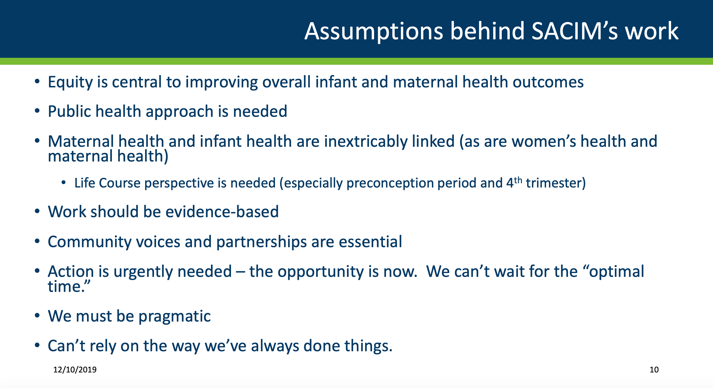
SACIM: Secretary’s Advisory Committee on Infant Mortality

Slide 20
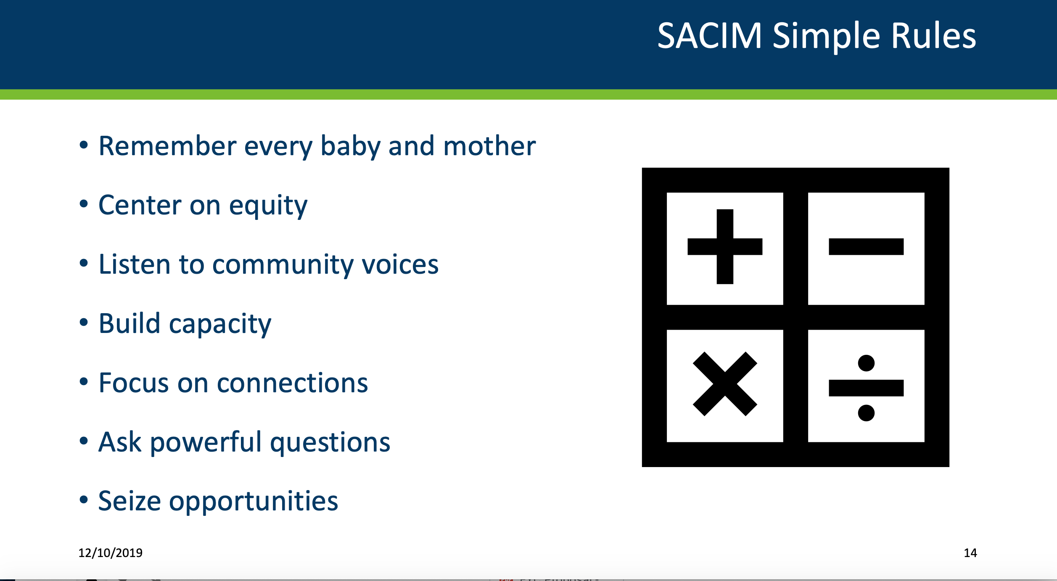
SACIM: Secretary’s Advisory Committee on Infant Mortality

Slide 21
MCH Organizational Racism Statement – Call to Action 09/2020
Partnering Organizations:
AMCHP
ASTHO
CityMatCH
MoD
NACCHO
NHSA
NICHQ,
The Opportunity:
Leading organizations in MCH align to a shared statement around how to be anti-racist and support our members in following suit. We identify accountability areas for ourselves (lead by example) and by default set the stage for our members to follow.
The Secretary’s Advisory Committee on Infant Mortality (SACIM) plans to address the public health crisis of racism, specific to preventing maternal and infant mortality and eliminating racial disparities and make strategic recommendations for consideration." Members of SACIM are committed to having the issue of systemic racism front and center in our discussions of maternal and infant mortality and are committed to bringing forth actionable recommendations for the Secretary and other organizations working to address the long-standing and on-going pandemic of systemic racism.

Slide 22
What will it take to achieve national EQUITY in infant mortality rates by 2030?
22

Slide 23
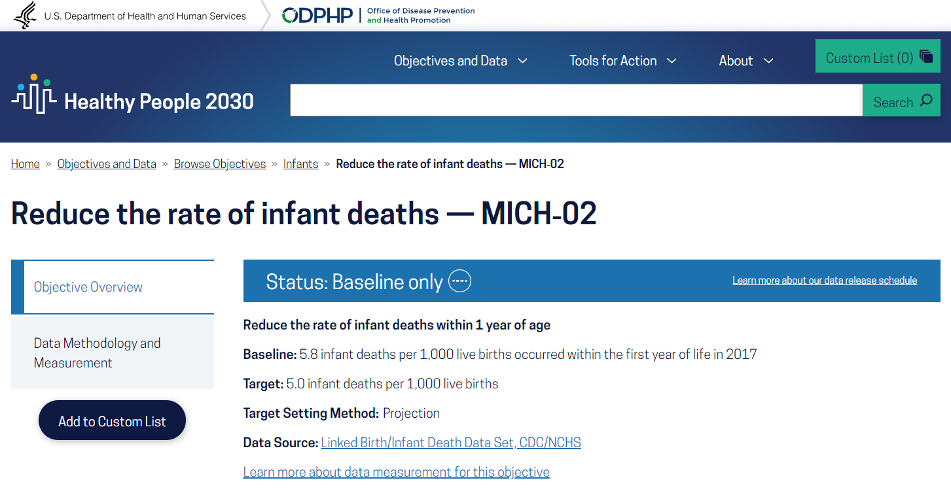
Healthy People 2030: IMR Goal = 5

Slide 24
Healthy People 2030: IMR Goal = 5
“Every year in the United States, thousands of infants die from causes like preterm birth, low birth weight, and sudden infant death syndrome. Although the rate of infant deaths has fallen over the past decade, there are disparities by race/ethnicity, income, and geographic location. Equitable, high-quality care for moms and babies and community-based interventions can help reduce the rate of infant deaths.
The U.S. Department of Health and Human Services released Healthy People 2030, the nation's 10-year plan for addressing our most critical public health priorities and challenges. Since 1980, HHS has set measurable objectives and targets to improve the health and well-being of the nation.
Healthy People has led the nation with its focus on social determinants of health, and continues to prioritize economic stability, education access and quality, health care access and quality, neighborhood and built environment, and social and community context as factors that influence health. Healthy People 2030 also continues to prioritize health disparities, health equity, and health literacy.”
Source: https://health.gov/healthypeople

Slide 25
Where Are We Now?
USA IMRs: 2016-2018
Of broad or bridged race/ethnic groups, only NH Black and AI/AN infants have not already met the HP 2030 target.
In fact, they have not even achieved the HP 2000 target (7.0) 30 years after it was set.
Even if they meet the HP 2030 target of 5, they wouldn’t achieve equity with NH White majority group.
Using the same target setting projection for the overall IMR, NH White infants are projected to reach 4.0 by 2030 – this is the true target for equity.
Source: United States Department of Health and Human Services (US DHHS), Centers of Disease Control and Prevention (CDC), National Center for Health Statistics (NCHS), Division of Vital Statistics (DVS). Linked Birth / Infant Death Records 2016-2018, as compiled from data provided by the 57 vital statistics jurisdictions through the Vital Statistics Cooperative Program, on CDC WONDER On-line Database. Accessed at http://wonder.cdc.gov/lbd-current.html

Slide 26
What Will It Take to Achieve Birth Equity in the USA?
Population | Annual Births | Current IMR | Reduction to Achieve Equity (Subtract 4.0) | Number of Annual Deaths Needed to Prevent (Multiply by Births/1,000)
NH Black | 583,439 | 10.9 | 6.9 | 4,026
NH AI/AN | 34,801 | 8.6 | 4.6 | 160
We need to save an additional 4,186 (Black and AI/AN) babies/year.
That’s fewer than 12 babies/day.
For context: ~10,500 babies born each day in the United States.
Notes: Uses 3-year average data (2016-2018) to improve stability of estimates and assumes constant births

Slide 27
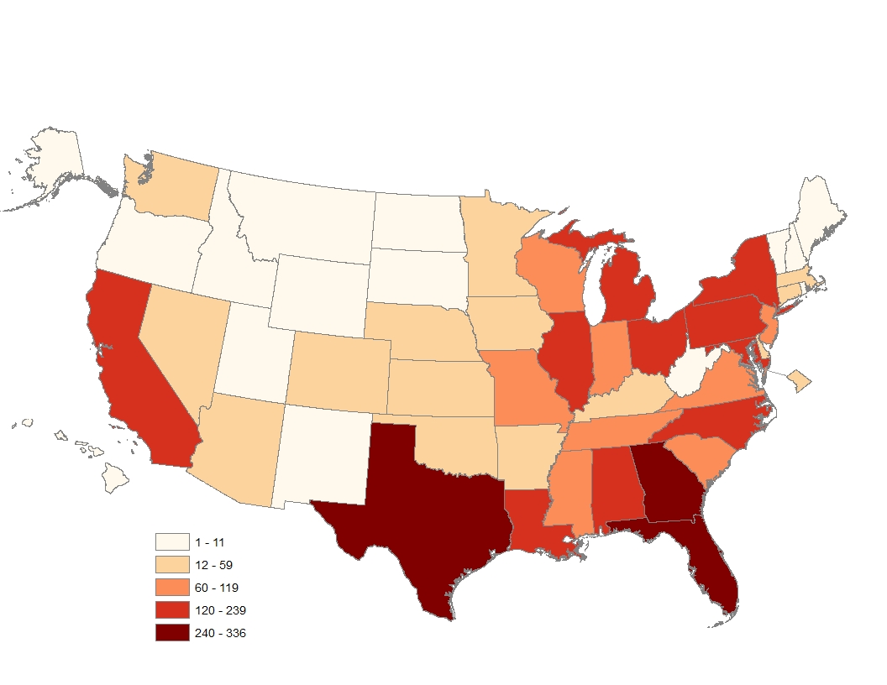
What’s the “Lift” at the State Level to Achieve Black-White Equity?
Black Infant Deaths to Prevent Annually | Black Infant Deaths to Prevent Monthly | # States | % of Total Black Infant Deaths to Prevent
1-11 | <1 | 15 | 1%
12-59 | 1-4 | 15 | 11%
60-119 | 5-9 | 8 | 19%
120-239 | 10-19 | 10 | 45%
240-336 | 20-28 | 3 | 24%
Number of Black Infant Deaths to Prevent Annually
Notes: Uses 3-year average data (2016-2018) with Bayesian spatial smoothing to improve stability of estimates and assumes a 15% improvement for White IMR (1-4/4.7)
Notes:
The data years are 2016-2018 and should be included in the source footnotes (see second slide set I sent since the first were not visible with white font). The calculations we made were to determine the number of black infant deaths that needed to be prevented to achieve equity with the white rate by 2030. Since the disparity exists everywhere, it is predominantly affected by the number of black births. Thus, we’re not identifying “poor performers” here but really population concentrations and helping to translate for states/counties how many deaths need to prevented as a hook for engagement. For example, states could see how many they need to prevent and which counties they might focus on. There are certainly a few states and counties that contribute a lot but still 43% of the total deaths that we need to prevent are in 716 counties with fewer than 1 death to prevent monthly. These counties are located in all but 3 states so almost every state must engage to get to the overall goal. Even the largest counties have only about 10 deaths to prevent per month so this should be achievable. Those top 3 counties with the most births and deaths are Cook County, IL, Harris County, TX, and Wayne County, MI so Chicago, Houston, and Detroit. Again, the disparity isn’t necessarily highest in these locations but they are the only three with more than 10,000 annual black births.
As part of the paper we’re working on, we are looking at the actual rates and disparity ratios to identify which counties have met or are close to meeting the targets and goal of disparity elimination (last version attached that I will work on updating to 2018 and finalizing in the next few months). We also were planning a thought piece and call to action framed around the survival lag and many of the thoughts that you included in your attachment. I’m sure Michael will weigh in as he’s able but let’s make this happen in 2020!

Slide 28
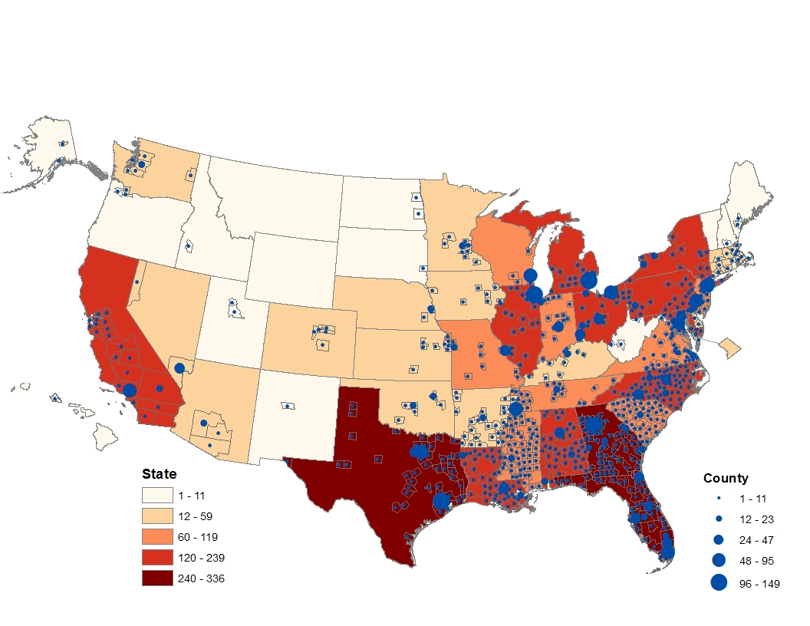
What’s the “Lift” at the County Level to Achieve Black-White Equity?
Number of Black Infant Deaths to Prevent Annually
Black Infant Deaths to Prevent Annually | Black Infant Deaths to Prevent Monthly | # Counties | % of Total Black Infant Deaths to Prevent
1-5 | <1 | 646 | 29%
6-11 |  | 70 | 14%
12-23 | 1 | 42 | 18%
24-47 | 2-3 | 21 | 18%
48-95 | 4-7 | 8 | 11%
96-149 | 8-12 | 3 | 9%
Notes: Uses 3-year average data (2016-2018) with Bayesian spatial smoothing to improve stability of estimates and assumes a 15% improvement for White IMR (1-4/4.7); 324 counties had no Black births and 2,023 counties had too few births to expect one death per year
Notes:
The data years are 2016-2018 and should be included in the source footnotes. The calculations we made were to determine the number of black infant deaths that needed to be prevented to achieve equity with the white rate by 2030. Since the disparity exists everywhere, it is predominantly affected by the number of black births. Thus, we’re not identifying “poor performers” here but really population concentrations and helping to translate for states/counties how many deaths need to be prevented as a hook for engagement. For example, states could see how many they need to prevent and which counties they might focus on. There are certainly a few states and counties that contribute a lot but still 43% of the total deaths that we need to prevent are in 716 counties with fewer than 1 death to prevent monthly. These counties are located in all but 3 states so almost every state must engage to get to the overall goal. Even the largest counties have only about 10 deaths to prevent per month so this should be achievable. Those top 3 counties with the most births and deaths are Cook County, IL, Harris County, TX, and Wayne County, MI so Chicago, Houston, and Detroit. Again, the disparity isn’t necessarily highest in these locations but they are the only three with more than 10,000 annual black births.

Slide 29
Why should this be important to Ohio?

Slide 30
Ohio 2018 IMRs (and HP 2030 Goal)
(Health People 2030 Goal = 5)
5.4
13.9
6.1
3.2^
^ Rates based on fewer than 20 infant deaths should be interpreted with caution
Source: data from ODH, HP 2030 goal from HHS

Slide 31
The 10 States with the highest Black IMRs: 2018
 | State: | BIMR:
 | MI | 13.47
 | OH | 13.42
 | IL | 13.32
 | NE | 13.23
 | WI | 12.68
 | OK | 12.57
 | AR | 12.35
 | IN | 11.91
 | SC | 11.75
 | KS | 11.65
During 2018 Ohio is essentially
tied with Michigan for having the
highest BIMR in the nation!
MA BIMR: 8.35, lowest in 2018
Source: CDC Wonder

Slide 32
How has Ohio done relative to achieving prior Healthy People IMR Goals?

Slide 33
Ohio White and Black IMRs: 1990-2019
HP 1990
HP 2000
HP 2010
HP 2020
. B (12)
. D (11)
. A (9)
. C (7)
X
(1987)
. F(6)
y
z
1994
. E (4.5)
2013
Source: ODH/HRSA
Notes:
For HP 1990:
The Goals were to achieve an overall IMR of “9” by 1990 (A) and a Black IMR of “12” (B). Ohio achieved that overall IMR goal for White babies in 1987, in advance of the goal date.
HP 2000:
The Goals were an overall IMR of 7 (C) and a Black IMR of 11 (D). Ohio achieved the overall IMR for white babies in 1994, again in advance of he goal date.
HP 2010: The Singular Goal was that all groups achieve an IMR of 4.5. Neither Whites or Blacks in Ohio achieved that goal.
HP 2020: The single goal is that by the time we reach the end of this year (2020), that all groups achieve an IMR no greater than 6 (E). We achieved that goal for White babies in Ohio in 2013…again ahead of the goal date.

Slide 34
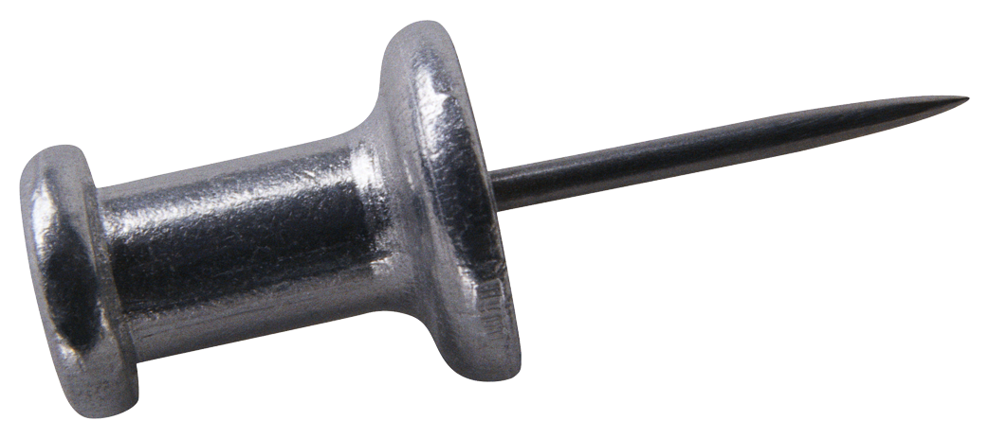
Ohio White and Black IMRs: 1990-2019
HP 1990
HP 2000
HP 2010
HP 2020
. B (12)
D (11)
A (9)
X
(1987)
C (7)
y
z
F(6)
1994
E
(4.5)
2013
Ohio has NEVER accomplished any Healthy Goal for Black Babies!!!
Source: ODH/HRSA
Notes:
In the nearly 4 decades of HP, Ohio has never achieved any HP IMR goals for Black babies….even though our State has achieved the Overall IMR goals for White babies in Ohio for 3 of the 4 decades of Healthy People…and Ohio achieved those goals in advance of the goal dates. This trend needs to end.

Slide 35
Cuyahoga County, City of Cleveland example:

Slide 36
Cuyahoga County Overall IMR: 1995-2019
12
8.6
28% improvement
1995-2003 is Vital Statistics data & 2004-present is from Child Fatality Review. Do not have racial
breakdown by ethnicity (i.e., black non-Hispanic) for historical data, all data by race alone.

Slide 37
Cuyahoga County Overall, White and African American IMR:
1995-2019
1995-2003 is Vital Statistics data & 2004-present is from Child Fatality Review. Because we do not have racial breakdown by ethnicity (i.e., black non-Hispanic) for historical data, all data by race alone.

Slide 38
Cuyahoga County White and African American IMR:
1995-2019
Disparity Ratio:
2.5x
4.4x
1995-2003 is Vital Statistics data & 2004-present is from Child Fatality Review. Because we do not have racial breakdown by ethnicity (i.e., black non-Hispanic) for historical data, all data by race alone.

Slide 39
Cuyahoga County White and African American IMR:
1995-2019
Disparity Ratio:
2.5x
21% Improvement
4.4x
1995-2003 is Vital Statistics data & 2004-present is from Child Fatality Review. Because we do not have racial breakdown by ethnicity (i.e., black non-Hispanic) for historical data, all data by race alone.

Slide 40
Cuyahoga County White and African American IMR:
1995-2019 (25-years)
Disparity Ratio:
21% Improvement
1995-2003 is Vital Statistics data & 2004-present is from Child Fatality Review. Because we do not have racial breakdown by ethnicity (i.e., black non-Hispanic) for historical data, all data by race alone.

Slide 41
African American infants in the USA die at a rate 2x that of White babies:
2x

Slide 42
African American infants in the Ohio die at a rate 3x that of White babies:
3x

Slide 43
African American infants in the Cuyahoga County die at a rate 4x that of White babies:
4x

Slide 44
African American infants in the City of Cleveland die at a rate 7x that of White babies:
7x

Slide 45
The W-IMR in Cuyahoga County improved 2.7x faster than the AA-IMR
This accelerated pace of improvement for one group relative to another group
IS NOT NATURAL. It occurs because of a historical mal-distribution of opportunity
on the basis of race. Years and years of policies, practices and systems that have
provided “advantage” to one group while, simultaneously, subjecting other groups
to disadvantage inevitably results in disparate outcomes.
To achieve EQUITY we have to reverse this trend…we have to accelerate the
pace of improvement of the BIMR more rapidly than we improve the WIMR…
AND we have to accomplish this accelerated pace without compromising our
efforts to improve the WIMR.
art james

Slide 46
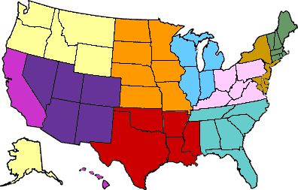


Erasing the Gap(s):
To eliminate the disparity, we need to:
Improve the bimr at a faster pace
than we improve the wimr
Must accomplish #1 w/o compromising
the rate of improvement of wimr
The Gap
Slide used with permission from Mrs. Cheryl Boyce
Slide shared by Mrs. Cheryl Boyce
Notes:
In a track event, if we want the running who is behind (runner #2) to catch to runner #1…
We can have runner #1 slow down…
We can teach #2 to run faster
We do this by learning from #1
Who was his/her coach
What were her/his training techniques?
Special diet?
Any other performing enhancing techniques
And we teach these techniques to #2

Slide 47
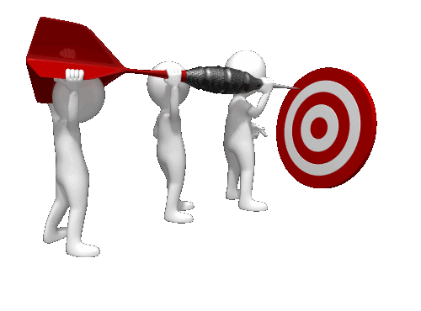
What’s our Goal?
Health Equity
Neighborhood
Revitalization
Universal Health Insurance
Access to Care
Poverty Reduction
Decrease
Health Disparities
Cultural Competency
Immigrant Inclusion
art james

Slide 48
“ Social inequality kills. It deprives individuals and communities of a healthy start in life, increases their burden of disability and disease, and brings early death.
  Poverty and discrimination,
  Inadequate medical care,
  and violation of human rights
all act as powerful social determinants of who lives and who dies, at what age, and with what degree of suffering.”
Nancy Krieger (2005). Health Disparities and the body. Boston: Harvard School of Public Health

Slide 49
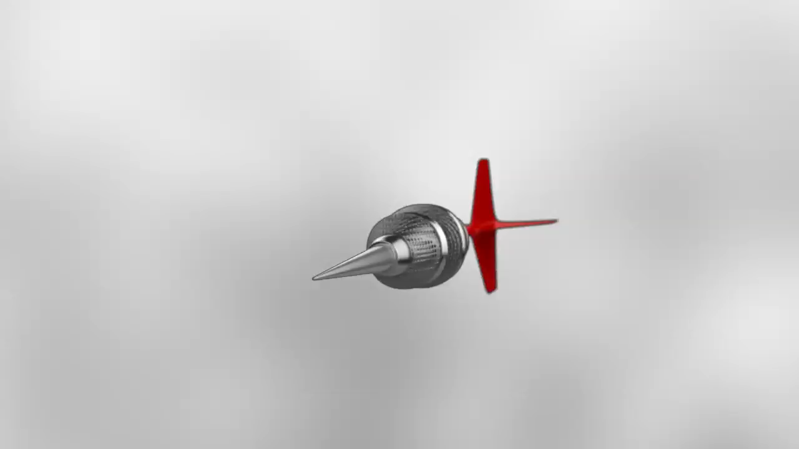
EQUITY should be our primary goal…all else is derivative
art james

Slide 50
Social justice is a matter of life and death. It affects the way people live, their consequent chance of illness, and their risk of premature death…
www.who.int/social_determinants

Slide 51

Persistent
Disparities
EQUITY
Notes:
This request is for Oho to draw a line in the sand…to take a sincere STAND and begin planning now for what it is going to take to ELIMINATE the racial disparity in the opportunity to survive the first year of life…and to achieve this goal by 2030.

Slide 52
What will it take to achieve HP 2030 goals in infant mortality rates in Ohio by 2030?
52

Slide 53
Ohio White and Black IMRs: 1990-2018
19.5
28.7% improvement
2.43
13.9
2.57
8
5.4
32.5% improvement
Source: ODH

Slide 54
Ohio White and Black IMRs: 1990-2018
Projections necessary to achieve HP 2030 Goal
HP 2030
13.9
64% improvement
5.4
G
7.4% improvement
G: Healthy People 2030 Goal is an IMR = 5
Notes:
HP 2030:
The one goal for HP 2030 is for all groups to achieve an IMR no greater that “5”
- Using Ohio 2019 White IMR as baseline, To achieve the HP 2030 goal for White babies in Ohio means improving the WIMR by 7.4% by the end of 2030. Projections by HRSA are that Ohio’s White IMR will be 4.8 by 2030.
- Using Ohio 2019 Black IMR as baseline, to achieve the HP 2030 goal for Black babies in Ohio means improving the BIMR by 64% by the end of 2030.

Slide 55
What will it take to achieve EQUITY?

Slide 56
Ohio White and Black IMRs: 1990-2018
Projections necessary to achieve EQUITY
HP 2030
13.9
65.5% improvement
. H
5.4
11% improvement
H: EQUITY Goal for Ohio is IMR = 4.8
Speculates that by 2030 the Ohio WIMR will be “4.8”, so what will it take for the BIMR to also be “4.8”
Notes:
Nationally HRSA predicts that the White IMR will be “4” by the end of 2030 but they predict that the Ohio WIMR will be 4.8. Therefore, to achieve EQUITY in IMR in Ohio by the end of 2030, our BIMR will need to improve by 65.5% to equal the predicted Ohio WIMR of 4.8.
It is November 10th of 2020 at the time of this presentation. If we are to have an opportunity to achieve these goals, Ohio leadership (State leadership as well as local leadership) needs to begin planning now for not only what it is going to take to achieve these goals, by also allocate the necessary programmatic interventions and resources to make this happen.

Slide 57
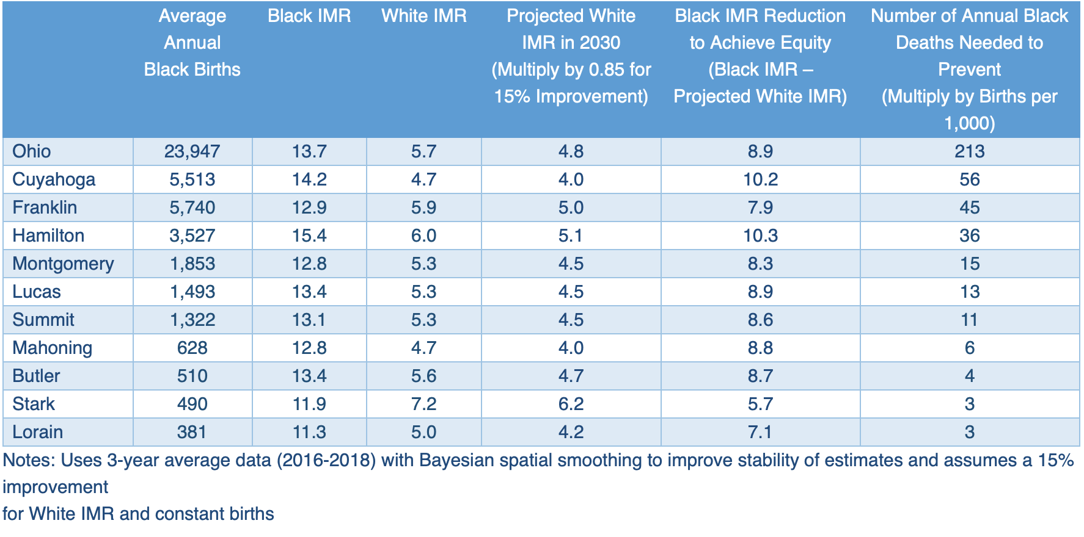
What would it take for Ohio and OEI** communities to achieve HP 2030
IMR Goals AND to achieve EQUITY in birth outcomes by the end of 2030?
*
* Lorain is not officially part of OEI, **OEI: Ohio Equity Institute
Analysis by Dr. Ashley Hirai, Epidemiologist @ HRSA

Slide 58
These will be incredibly difficult goals to achieve…
Whether Ohio strives to achieve HP 2030 IMR Goal of “5” or accepts the goal of achieving
EQUITY in the opportunity to survive the 1st year of life…it will take a great deal of
work AND a significant paradigm shift in our City, County and State approaches
to give all groups the best AND EQUITABLE chance of surviving the first year of life.
Aiming to ELIMINATE Racial disparities is an essential element to achieving these goals…
  Will require a targeted universal approach
We know that if we do not begin PLANNING NOW for what we need to do to achieve
EQUITY by 2030…it will not happen
  Planning that includes:
    Local (Neighborhood, City level)
      Including representation from communities most adversely effected
    County leadership
    State leadership
    Business
    Philanthropy

Slide 59
Why NOW?
The Nation, State, Counties, and Cities clearly have other more urgent priorities:
  COVID-19 Pandemic
  Opioid Epidemic
  Economic Recovery
  Racial unrest
  Community Policing

Slide 60
Why NOW? BECAUSE…
The well being of our Mothers and Babies should ALWAYS be one of our top priorities
This racial disparity in the opportunity to survive the 1st year of life is the most urgent MCH challenge and it has been allowed to persist in Ohio for far too long
    Ohio is shamefully one of the worst States in the Nation for a Black baby to be born…and it has been this way for decades
As far as I know, Ohio has never established a prospective Healthy People IMR or EQUITY plan…to achieve HP goals for all groups by the goal date
NOW is the time

Slide 61
Do we have any assets to help us achieve this goal?
Senate Bill 332
Governor DeWine’s commitment to children
    Including significant increase in home visiting
Ohio Commission on Minority Health
Ohio Institute for Equity in Birth Outcomes (OEI)
Ohio Collaborative to Prevent Infant Mortality (OCPIM)
    Your advocacy will be ESSENTIAL if this is to happen
Ohio Commission on Infant Mortality
Federal Government’s commitment to eliminate racial disparities in birth outcomes, including substantial recent investments in Ohio
  Healthy Start (Ohio has 5 Healthy Start sites) and substantial investments toward improving Maternal Morbidity and Mortality
HPIO’s template for addressing SDOH to improve infant mortality
    https://www.healthpolicyohio.org/wp-content/uploads/2018/01/SDOIM_ExecutiveSummary_posted.pdf
Nationally: a social movement for Social Justice, to achieve EQUITY

Slide 62

Ohio SHIP: 2020-2022
The SHIP is a tool to strengthen state and local efforts to improve health, well-being and economic vitality in Ohio. The SHIP’s main components are: Six priorities including three factors and three health outcomes
  Thirty-seven measurable objectives
  A menu of evidence-informed strategies
  An evaluation plan to track and report progress
With the long-term goal of ensuring all Ohioans achieve their full health potential, the SHIP takes a comprehensive approach to achieving EQUITY and addressing the many factors that shape our health, including housing, poverty, education and trauma.
https://odh.ohio.gov/wps/portal/gov/odh/about-us/sha-ship

Slide 63
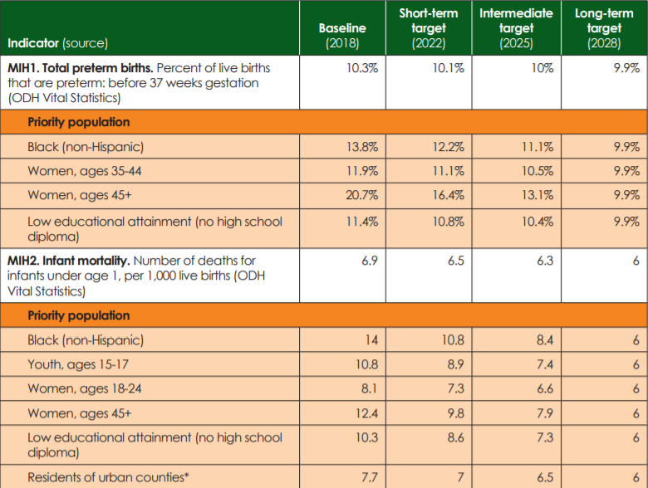
2020-2022 State Health Improvement Plan
Targets for infant mortality
*County typology from the Ohio Medicaid Assessment Survey. See Appendix C for map of county types. Target source: ODH

Slide 64
So…what’s our “ask”?
What are we asking Ohio to do?

Slide 65
Develop a plan…
OWN our results and our State’s status as one of the worst places in the Nation for an African American baby to be born…and DO SOMETHING ABOUT IT!
DEVELOP A PLAN:
  At the City, County and State level that aims to eliminate the racial gap in the opportunity to survive the 1st year of life

Slide 66
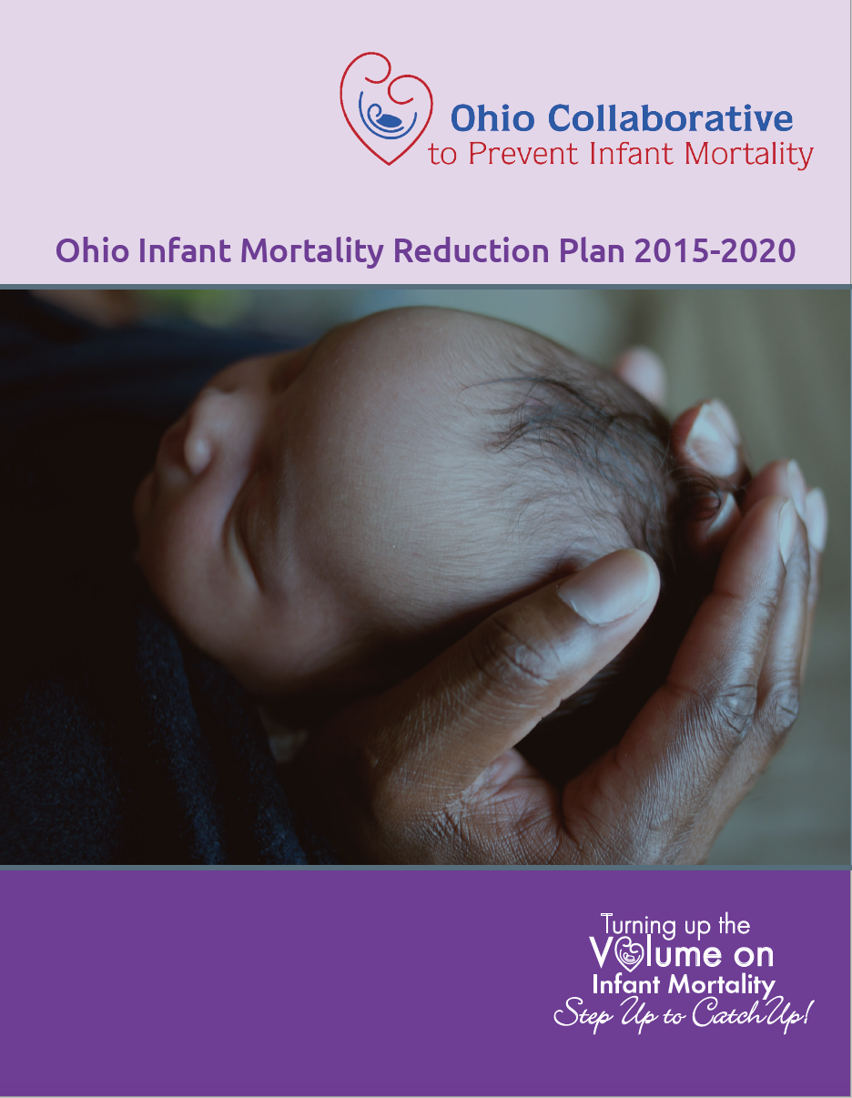
Strategic Focus Areas:
  Improving Health Equity, Addressing the SDOH and Eliminating Racism
  Promoting Optimal Women’s Health Before, During and After Pregnancy
  Preventing Premature Births
  Preventing Birth Defects
  Promoting Optimal Infant Health
  Reducing Smoking Before, During and After Pregnancy
  Promoting Fatherhood Involvement in Maternal and Child Health

Slide 67
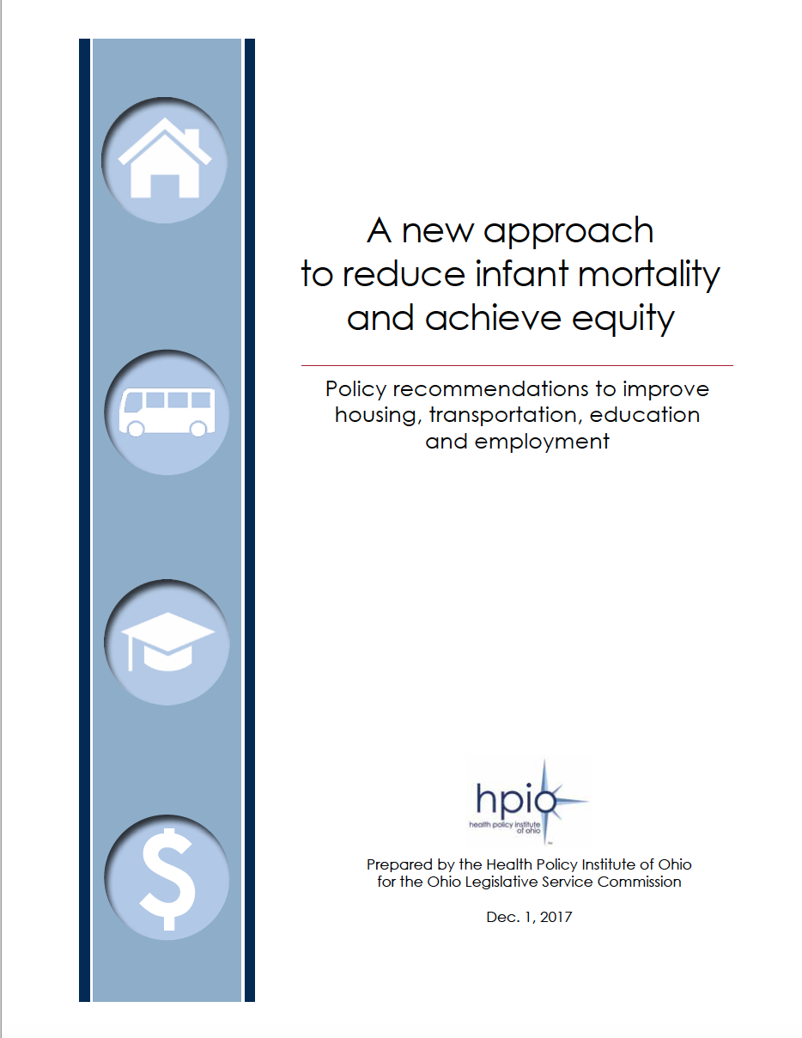
As a consequence of Senate Bill 332, HPIO
conducted a study and provided us with a
template to understand how SDOH
influence infant mortality

Slide 68
Interventions to consider:
Is it time for this Commission to champion another Senate Bill?
SDOH – test and then scale (ex. stable housing)
Maintain Medicaid Expansion
Postpartum Medicaid Coverage – 12 months for all women
Minimum Wage increase?
Clinical Providers of Color
More training (implicit bias) & tracking re health care bias
Paid Family Leave
Baby Bonds?
Reparations?
More Certified Doulas, More Group Prenatal Care
Earned Income Tax Credit
Change workplace policies to be more maternal friendly
Eliminate Racism: embrace RAPHC movement
More robust Statewide Safe Sleep and Breastfeeding campaign
Willingness to “course correct” when we fall behind our goals
Empower OCPIM
OEI:
  Better funding
  More robust Evaluation of local influence on improving IMR
HPIO Reports. Why aren’t we following their recommendations?
  SDOH and IMR
  Racial Equity
Engage MCH organizations:
  March of Dimes
  Ohio Chapters of:
    American Academy of Pediatrics
    American Congress of Ob/Gyn
    AWHONN
Increase engagement of OHA

Slide 69

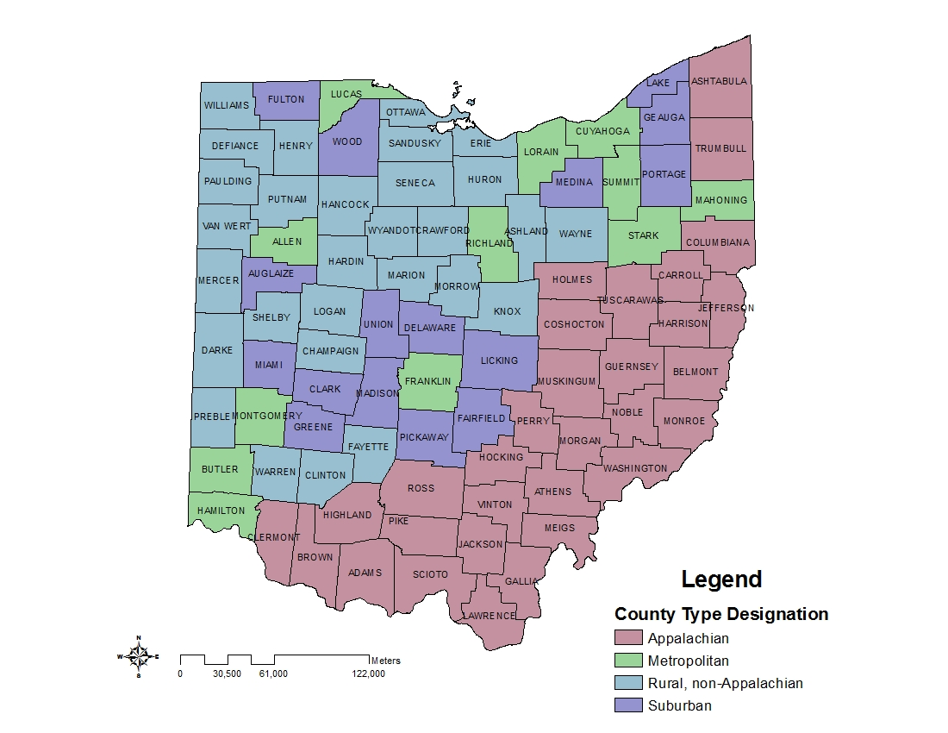

Advocacy is Essential:
Every Baby Matters…
  White, Black, Brown, or Yellow
  Rich or Poor
  Rural or Urban
  From the North, South, East or West
  Republican or Democrat
  From a family that is “Right-to-Life” or “Pro-Choice”
  Citizen or Immigrant
  Teen or Older Mom
  Whether or not Mom uses drugs, drinks Alcohol, or smokes cigarettes
  College graduate or not, our position should be that…
Any baby who takes his or her first breath within the borders of this State is our responsibility
and we can and must do better!
art james

Slide 70
We know that we will not be able to save every baby….but

Slide 71
Boy & Starfish – Making a Difference
I awoke early, as I often did, just before sunrise to walk by the ocean's edge. As I moved through the misty dawn, I focused on a faint, far away motion. I saw a youth, bending and reaching and flailing arms, dancing on the beach, no doubt in celebration of the perfect day soon to begin.
As I approached, I sadly realized that the youth was bending to sift through the debris left by the night's tide, stopping now and then to pick up a starfish and then standing, to heave it back into the sea. I asked the youth the purpose of the effort. "The tide has washed the starfish onto the beach and they cannot return to the sea by themselves," the youth replied. "When the sun rises, they will die, unless I throw them back to the sea."
As the youth explained, I surveyed the vast expanse of beach, stretching in both directions beyond my sight. Starfish littered the shore in numbers beyond calculation. The hopelessness of the youth's plan became clear to me and I countered, "But there are more starfish on this beach than you can ever save before the sun is up. Surely you cannot expect to make a difference."
The youth paused briefly to consider my words, bent to pick up a starfish and threw it as far as possible. Turning to me he simply said, "I made a difference to that one."
I spent the rest of the morning helping the boy throw starfish in to the sea.
Source: Based on the story by Loren Eisley

Slide 72
Thank you

