Slide 1
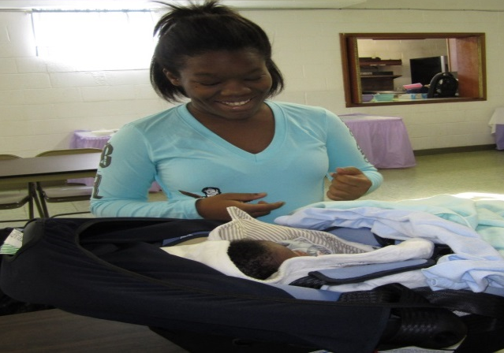
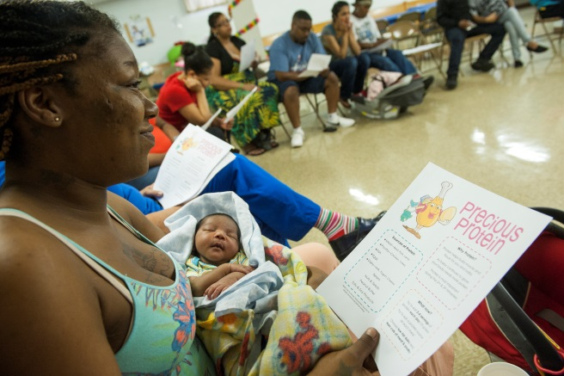
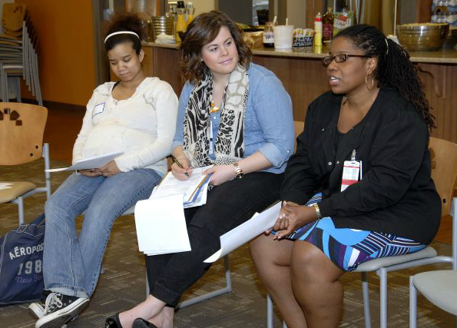
Commission on Infant Mortality Presented by
Twinkle Schottke, MA, EMCH
October 11th, 2017
Moms2B –
It’s Working!

Slide 2
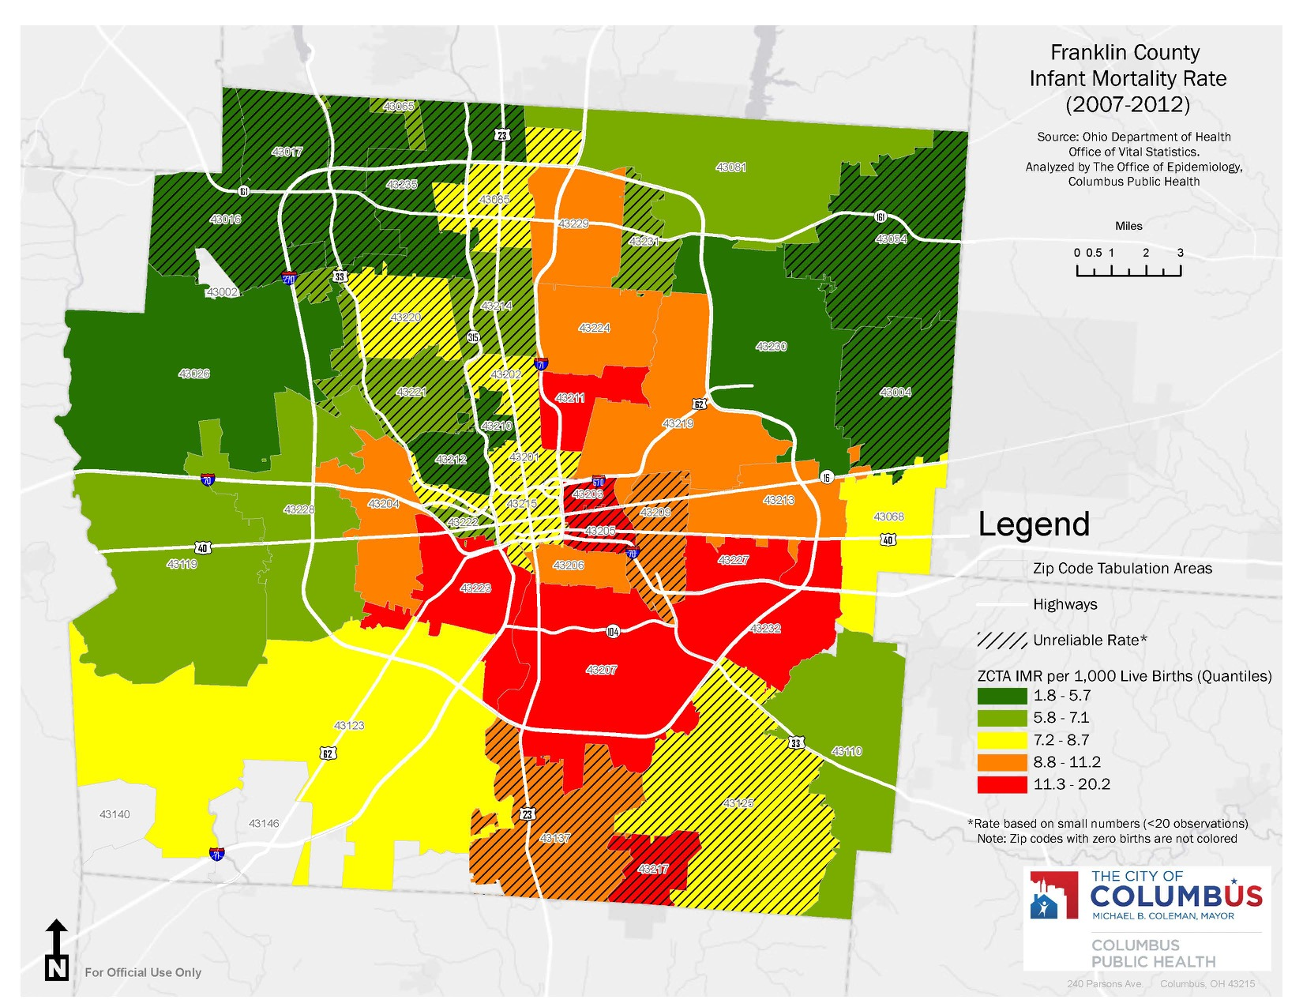
Number of pregnant women attending at least once at each Moms2B site. Total = 1037 9-11-2010 thru 12-31-2016
Linden began 2-2017
Weinland Park N=315 began 9-2010
OSU East N=422 began 11-2011
Mount Carmel West N=189 began 4-2014
South Parsons N=111 began 7-2014
Southeast (Refugee Road) began 5-2017
Notes:
Our Weinland Park zip code has changed from orange to yellow. Still too many red areas.

Slide 3
Infant Mortality in Weinland Park before and after Moms2B Before Moms2B 8 infant deaths/ 529 births (5 years) After Moms2B 1 infant death/328 births (4 years)
8 infants died
Data from Columbus Public Health

Slide 4


Components of Moms2B
Weinland Park
Near- East
Franklinton Mount Carmel
Southside
Linden
Weekly 2 hour session at each location
Group Education:
  Nutrition
  Stress reduction
  Breastfeeding
  Safe sleep
  Reproductive health
Prenatal:
  Connect to prenatal care
  Address social determinants of health
Postpartum:
  Nurse home visit
  Breastfeeding support
  “Baby’s First Year” group
Hilltop
Northeast
l
Southeast

Slide 5
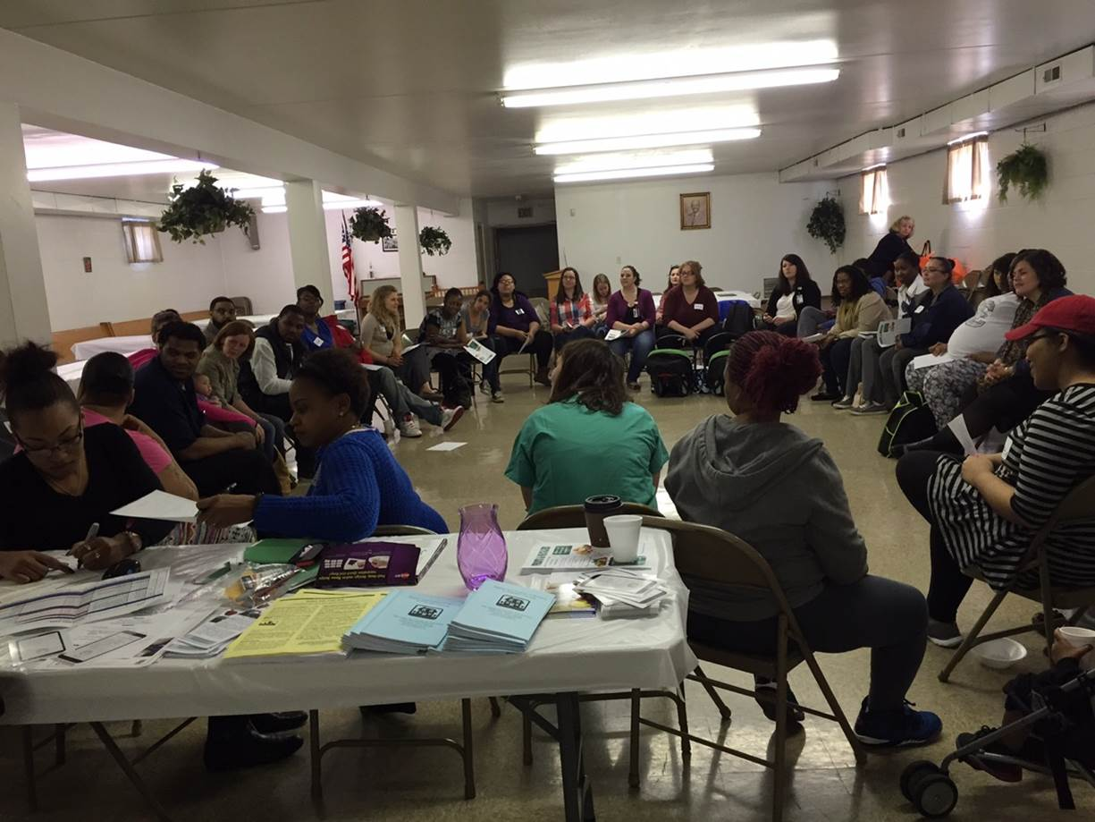

Slide 6
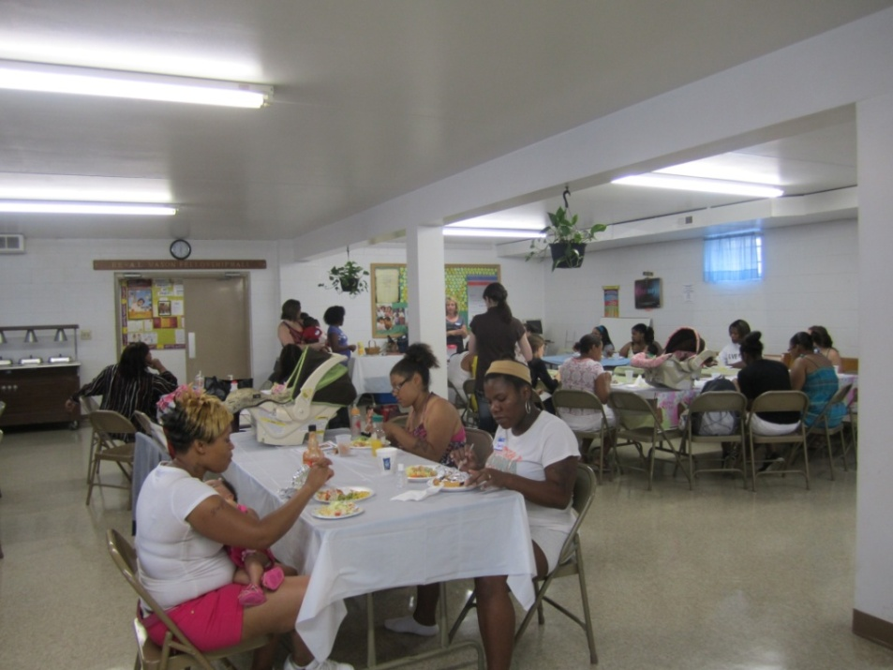
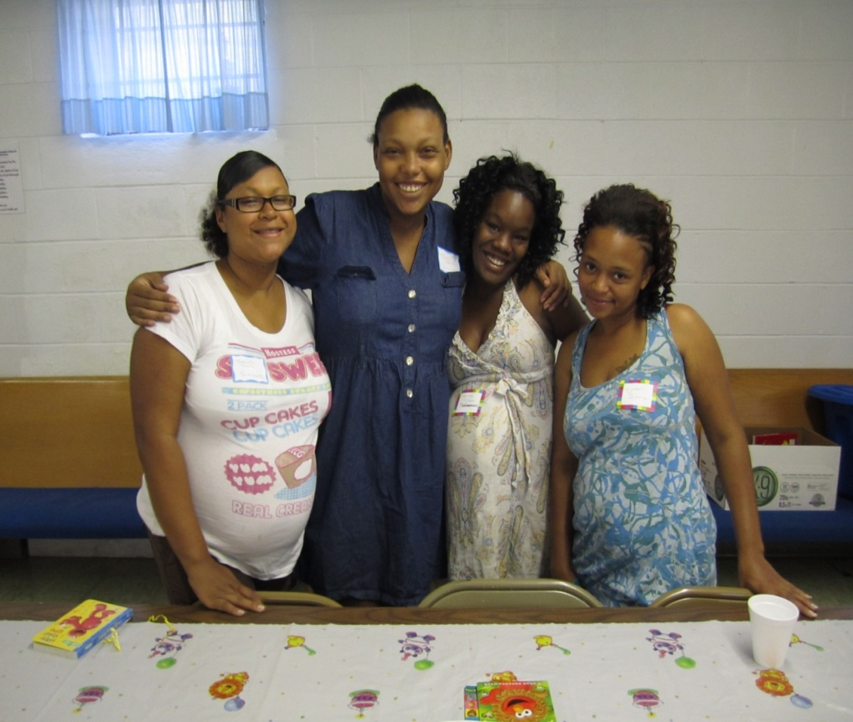
Moms2B Sample Weekly Schedule
Today’s Topic: Breastfeeding
Volunteer today:
Dale Dubler – OSU retired Physical Therapy
Schedule
11:00 - Check in and take siblings to Kids area
11:15 - Sister Circle – question of the day “Who is your Mentor or Role Model?”
  Carmen’s Nutrition Lesson – Prenatal Vitamins
  Brandy Bites– Positive Affirmations
11:45 - Group Lessons
  Breastfeeding – Maintaining Milk Supply
  Baby’s 1st Year – Play what to expect from your baby at this age? with Jenna
12:15 - Individual Charts and Checklists
12:30 - Eat Together
Baked Chicken, Roasted Potatoes, Steamed Broccoli, Homemade Bread, Salad, Fruit Cobbler, Frozen Yogurt
See YOU next Week!

Slide 7
Look at our Moms:
Moms2B
Average age | 23 (12- 49)
% Monthly Income < $800 | 78%
Prior Preterm Birth n=92 | 16%
Anemia | 23%
Asthma | 20%
Hypertension | 11%
Diabetes | 5%
%

Slide 8
What We Are Working on…
  Short term:
    We work directly with at-risk Moms to
      Identify and address social determinants of health to ensure they have a healthy and safe pregnancy
      Connect them to high quality prenatal care and provide timely and relevant health education
  Long term:
    We work to improve next pregnancies through:
      Promoting safe spacing
      Improving health behaviors
      Facilitating relationships between care providers
    We build a knowledgeable, skilled, and culturally competent MCH workforce

Slide 9
Another Success! Smoking Decreased and Breastfeeding Increased
SMOKING
BREASTFEEDING

Slide 10
How we are Funded

Slide 11
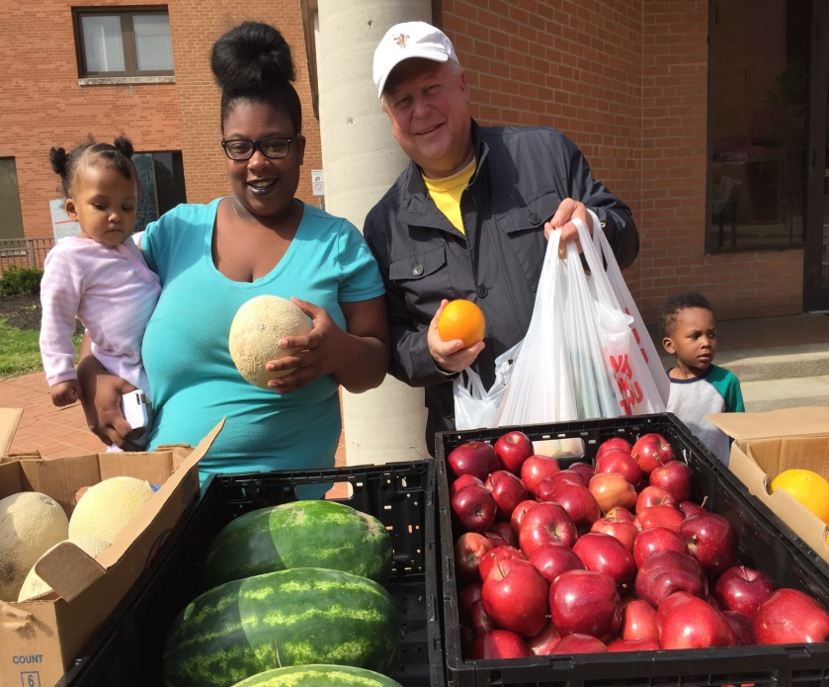

Many Moms Have Food Insecurity

Slide 12
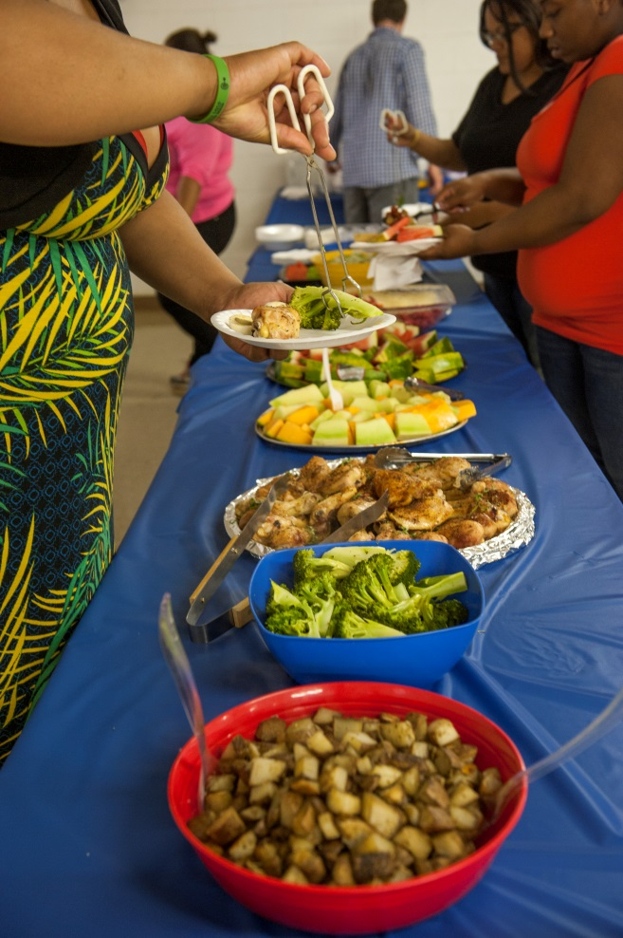
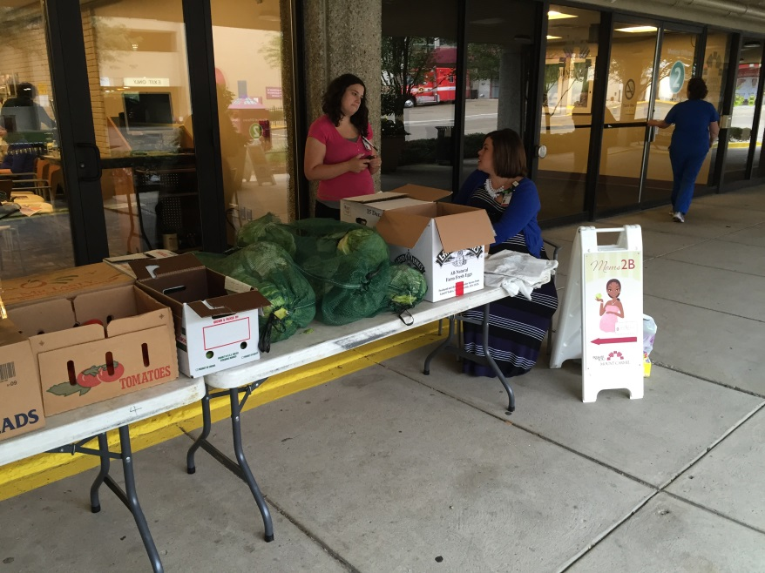

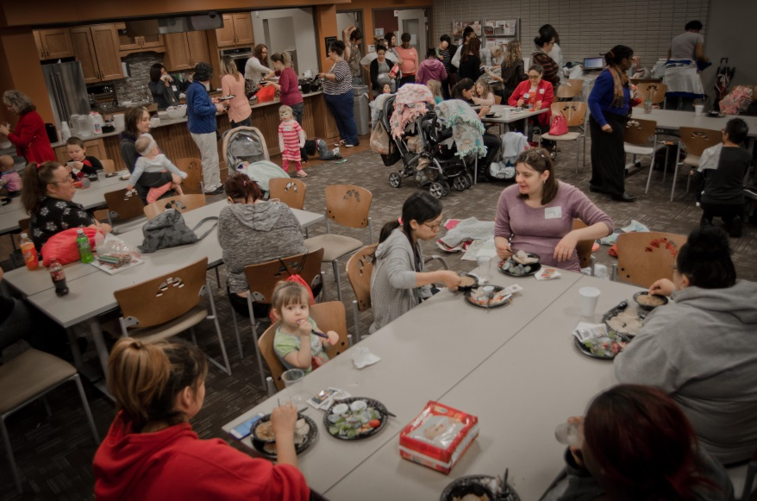
Moms2B
Caring through FOOD!
Taking care of Mom so she can take care of Baby.

Slide 13
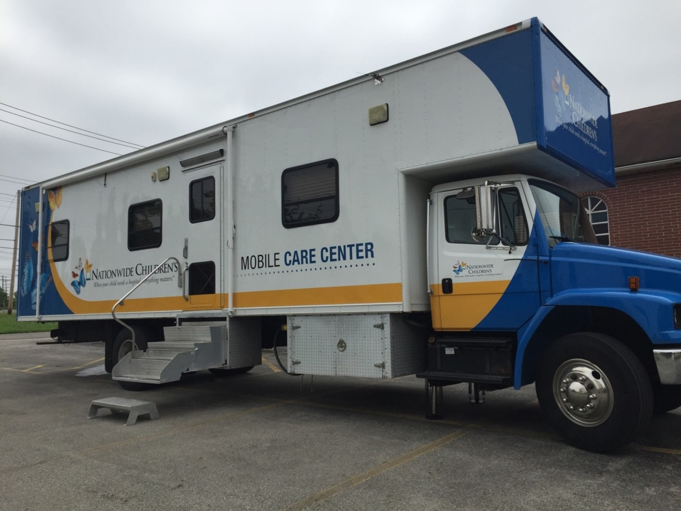
Connecting to Primary Care

Slide 14
Moms2B and Stress
Summary of 40 pregnant women in Moms2B answering standard questionnaire “Prenatal Hassles” (2013)

Slide 15
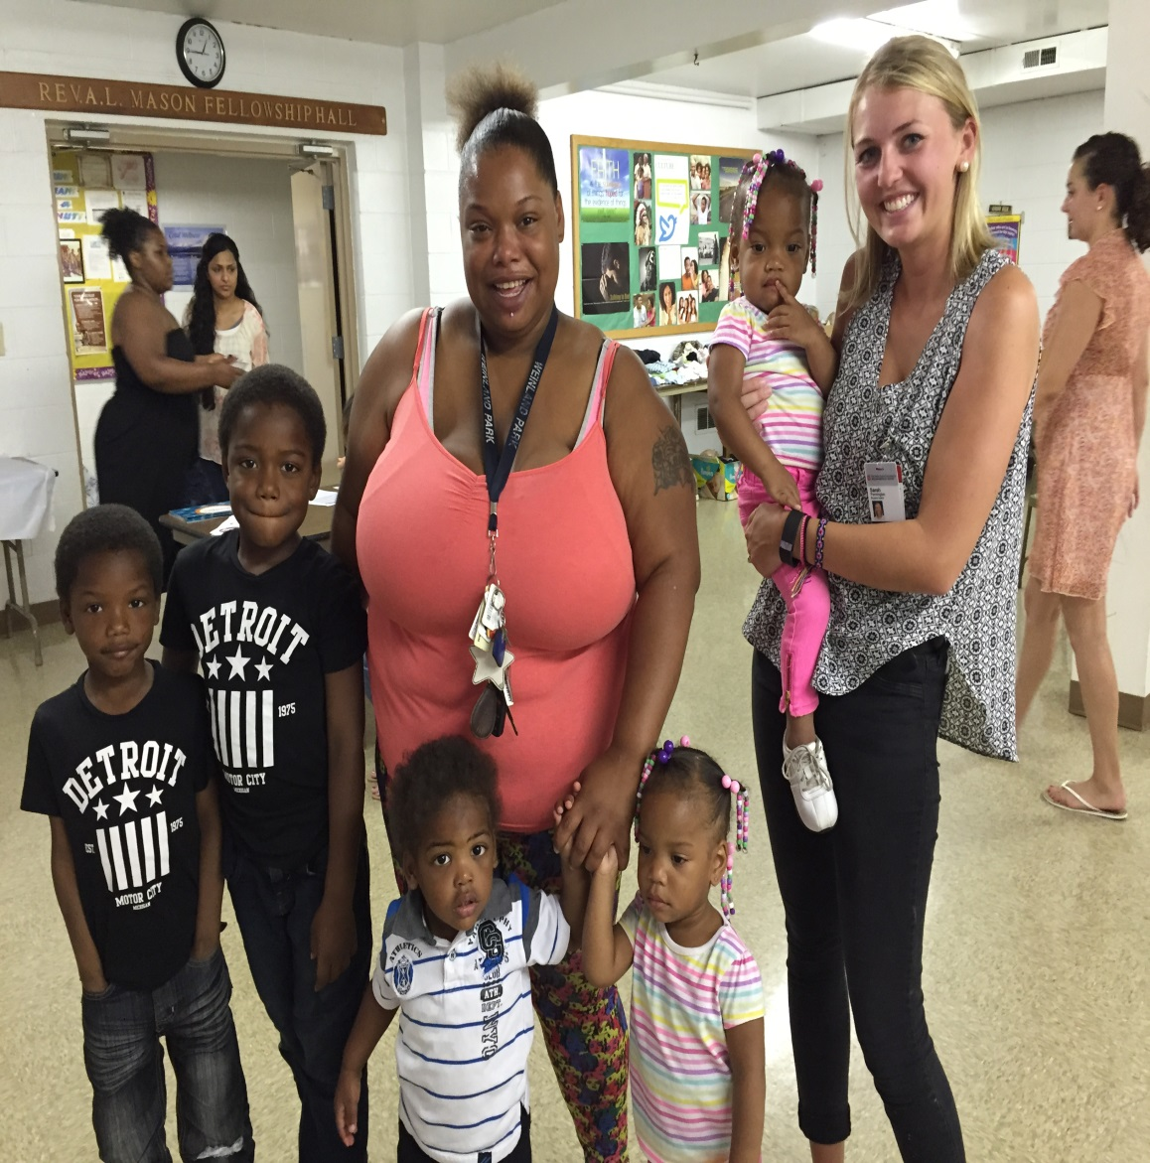
Moms!
  We refer to the wonderful women we work with as "Moms"!
  We use "push-ups" and encouragement as a way to educate and we never, never give up!
  By meeting each mom "where they are" we are able to build on the strengths or gifts they have and move forward.

Slide 16

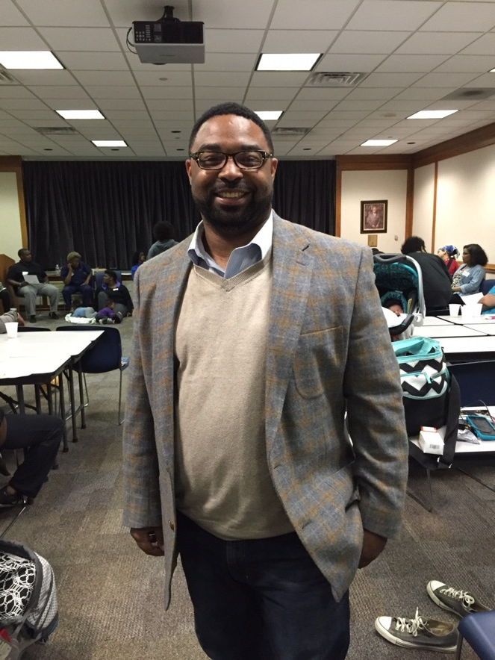
Engaging Fathers

Slide 17
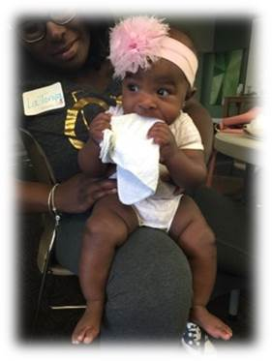
Moms2B Babies – Pointing out the Good!
Each baby receives a “Welcome to the World Bag” including a hospital visit and a team of people excited to meet them!
Reading baby cues and knowing what baby needs is sometimes difficult.
By talking for the baby a Mom can hear a different way of thinking.

Slide 18
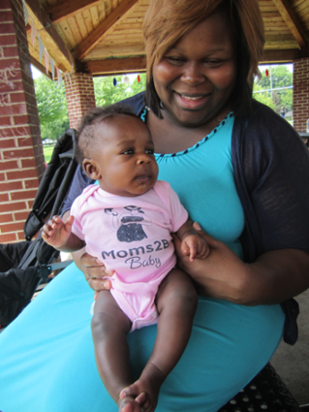
What’s working…
Moms2B addresses the social determinants of health through community based group education and case management
Infant mortality has improved in Weinland Park area
  Breastfeeding rates have increased
  Fewer preterm births <32 weeks gestation
  Improved postpartum depression scores
Research Underway
  Vital Statistics Birth and Infant Deaths- Outcomes for Moms2B participants
  Perinatal depression
  Housing insecurity
  MyChart Pilot “know your numbers”
PCORI Proposal
  Moms2B RCT
Ongoing opportunities
  Fatherhood role
  Jobs, Job training and Education needs
  Biggest need Transportation & Housing
  Need for Managed Care contracts

Slide 19
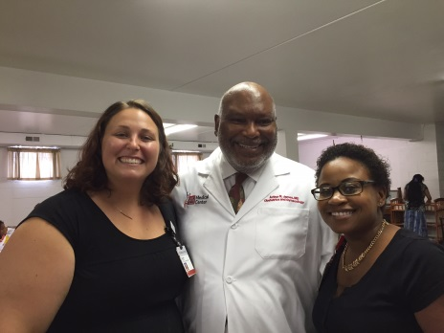
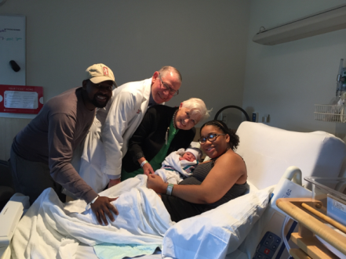
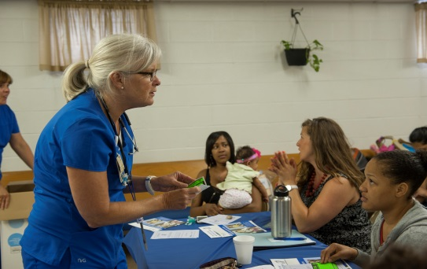
Thank you again for all that you are doing to help Moms have healthy babies!

Slide 20
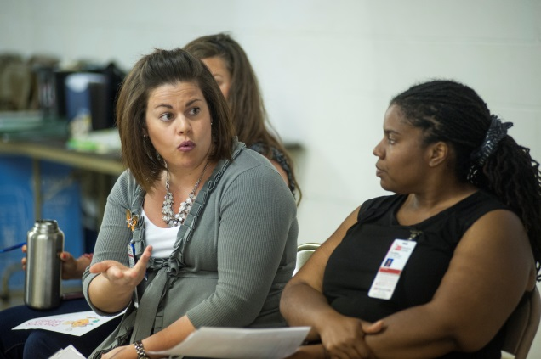
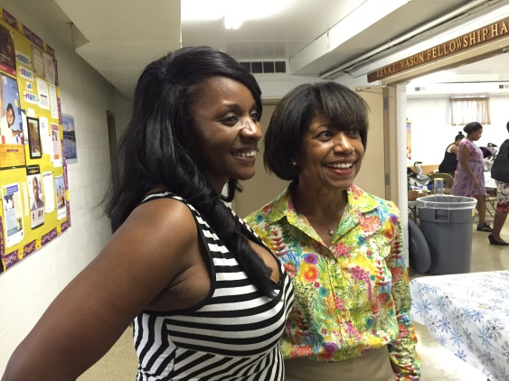
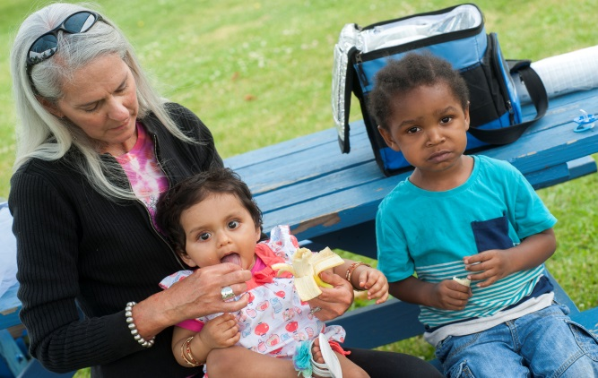
www.Moms2BOhio.com
Contact:
Twinkle Schottke: Twinkle.Schottke@osumc.edu
Moms2B Central Office:
921 Chatham Lane ~ Suite 108
Columbus, OH 43221
614-292-1605
Patricia Temple Gabbe MD MPH
Pat.gabbe@osumc.edu

